Slide 1
Challenges of Leadership for Mission in a World of Difference
1. Prophecy/Visioning
2. Care of members
3. Administration and Stewardship (McBride)

Slide 2
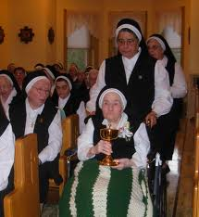

Maintenance v Mission
Focus on needs of ageing members
Dealing with majority of O/S born members
Simply keeping up with changes in compliance
75% organisational change efforts do not yield promised results (Deschryver-Mueller)
Working hard to get people to work together peaceably let alone effectively

Slide 3
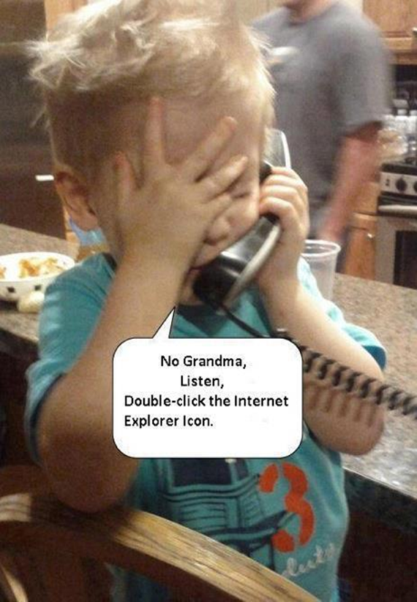
Diversity
“Holding diversity lightly” (McBride)
Ethnicity/culture
Generation
Educational background
Gender
Ministries
Personalities

Slide 4
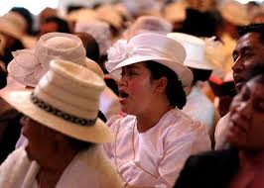
Leadership Models I
One in four born O/S
One in two have a parent born O/S
8 national conferences Uniting Church
Variety of Catholic ethnic chaplaincies
What impact do they have on leadership in God’s Mission?

Slide 5
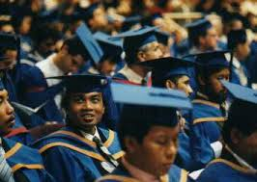
Leadership Models II
Contemporary: education / expertise
Kinship seniority and formal education
Theological expertise in Australian parishes?

Slide 6
Appointment / Election
Appointed leaders often efficient
Elected leaders often good observers / listeners
Mixed cultural group – some seek dynamic movement while others prefer relationships

Slide 7
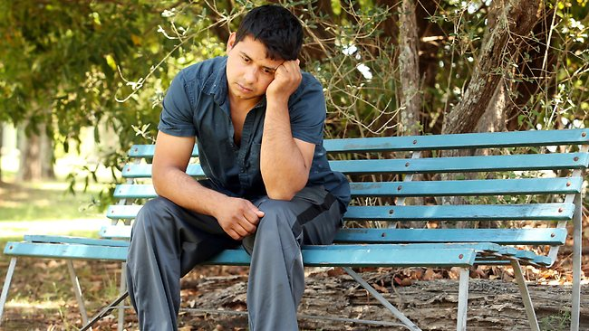
Consensus
What is to be achieved and how it is to be done?
Gather, inform, listen

Slide 8

Pastoral Practice
New worldviews and cultural practices have implications for:
Discipleship
Pastoral care
Decision-making
Conflict-resolution

Slide 9
Well-being of Leader
Spiritual Leader moves in honest wonder and openness to discover and point to signs of goodness, grace, courage and hope… which suggest presence of a greater power for good in the universe. (McRae-MacMahon)

Slide 10
