Slide 1
“Crying with the Suffering”
Mission-one heart many voices
2015

Slide 2
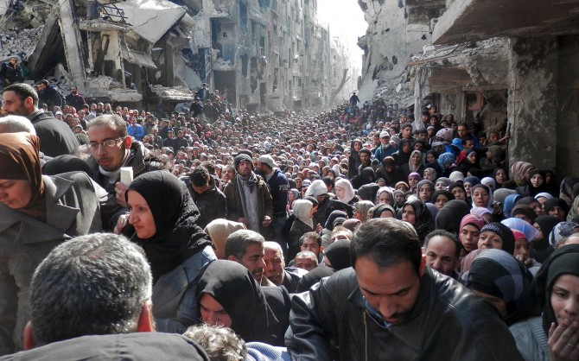
Notes:
The Guardian best pictures 2014

Slide 3
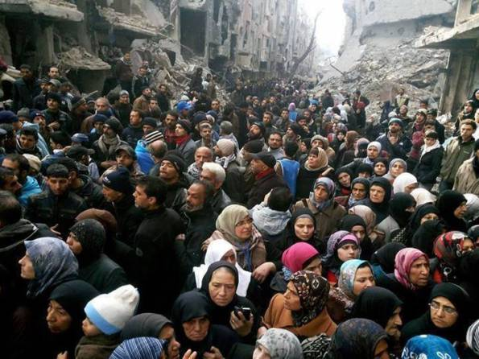
Yarmouk Refugee Camp, Syria
24th February 2014

Slide 4
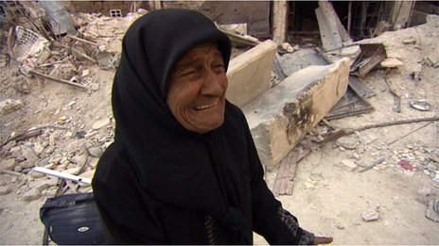
Wafiqu: “Self appointed spokesperson for the suffering” BBC

Slide 5
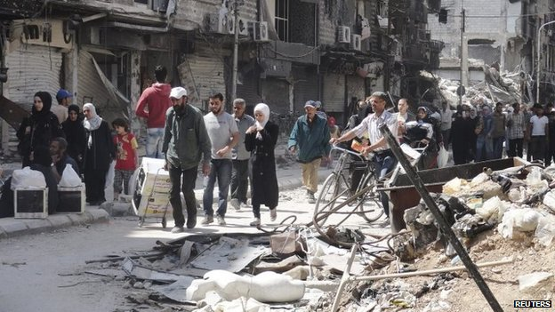
22 June 2014
18,000 still under siege (BBC)

Slide 6
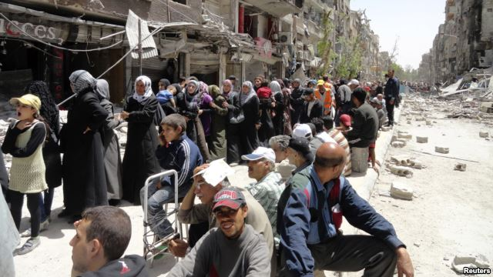
End of 2014 World Food Program (WFP) ceases giving food vouchers to Syrian refugees

Slide 7
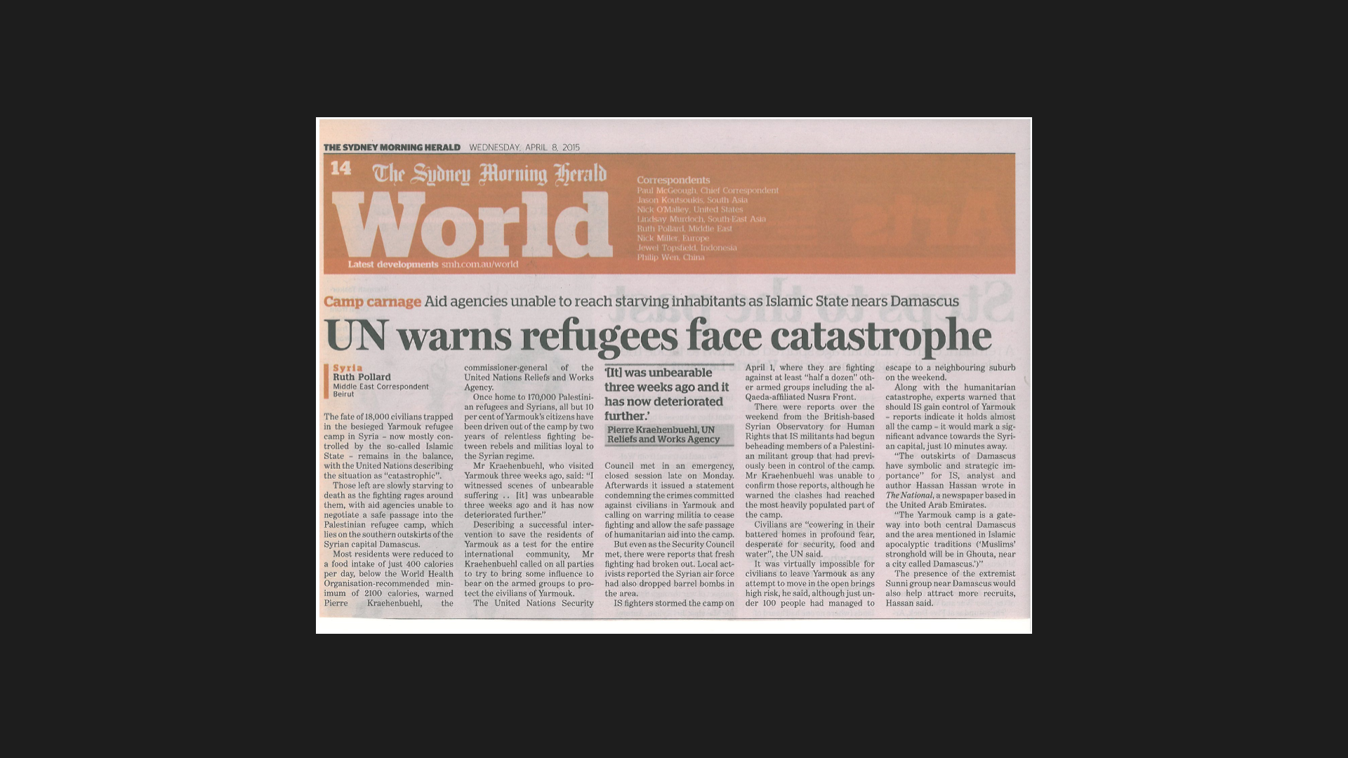

Slide 8
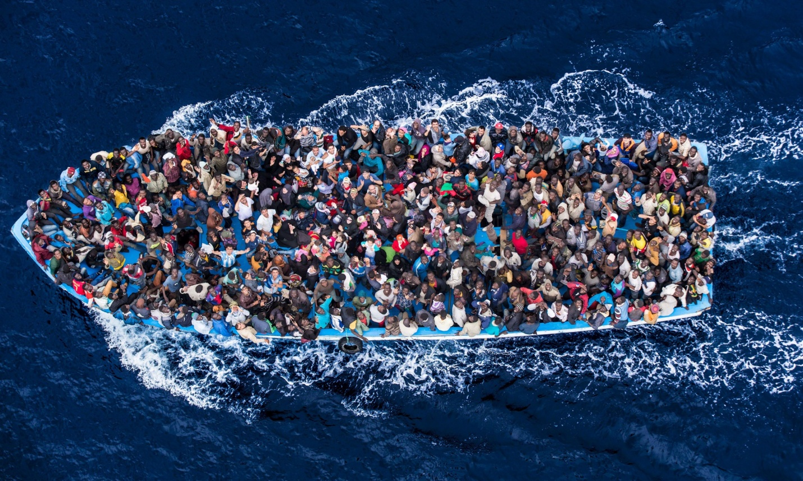
Asylum seekers in the Mediteranean

Slide 9
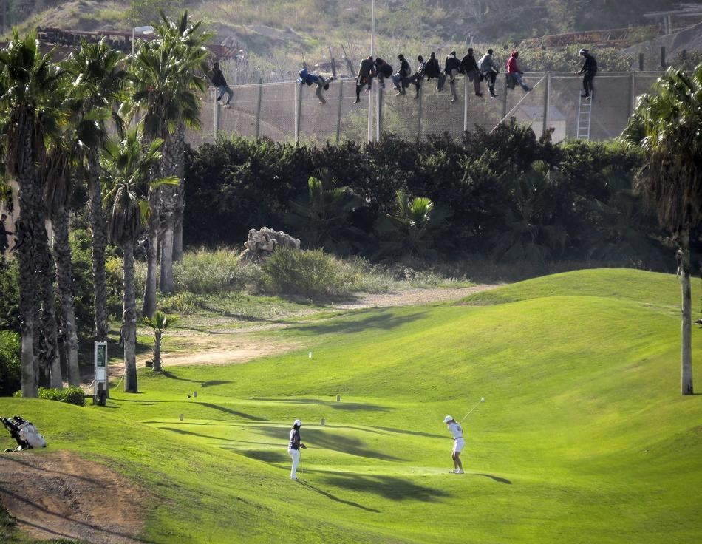

Slide 10
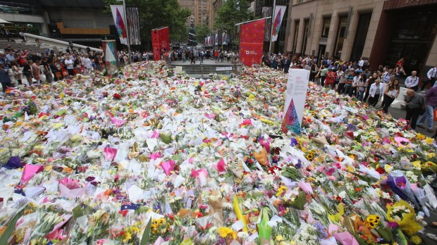
Martin Place, December 17, 2014

Slide 11
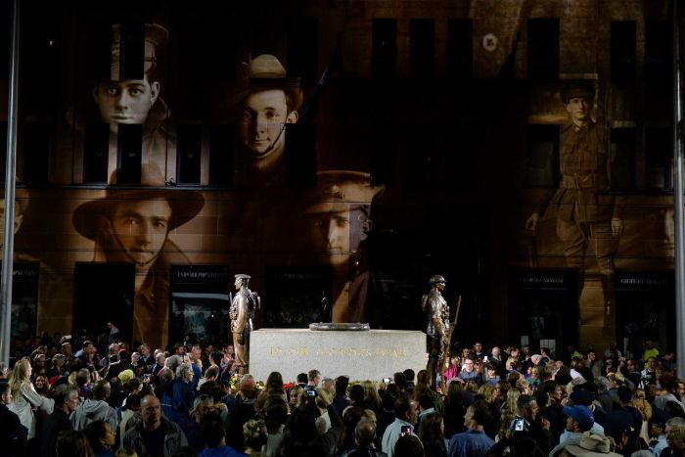
The Gallipoli Campaign

Slide 12
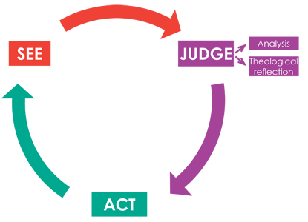
Notes:
http://www.socialjustice.catholic.org.au/spirituality-for-justice/10-social-teaching/94-reading-the-signs-of-the-times

Slide 13
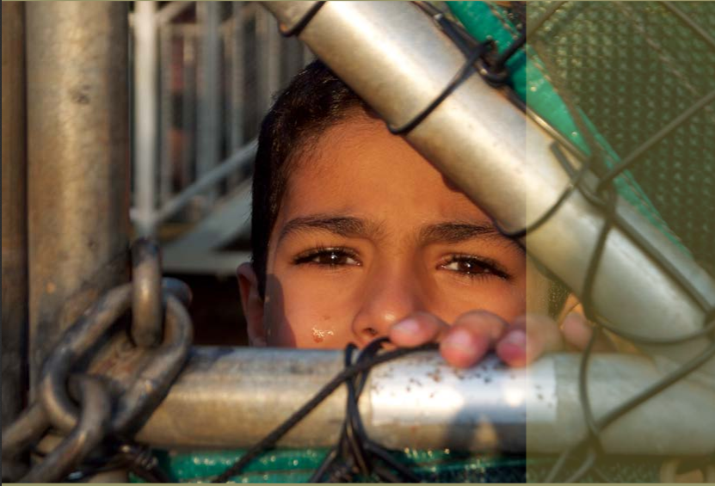
The Forgotten Children

Slide 14
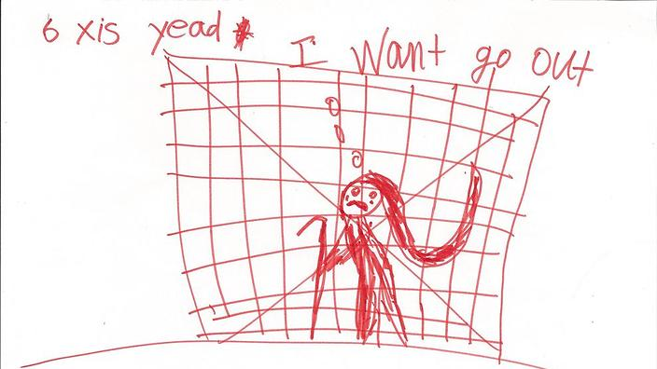

Slide 15
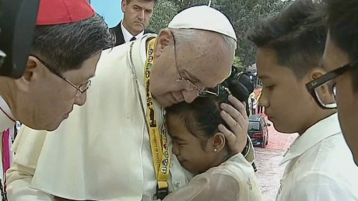
"Why did God let this happen to us?
Notes:
Philippines Jan 17th 2015

Slide 16
Pope Francis’s reply
"Only when we too can cry about the things that you said are we able to come close to replying to that question,“
"Certain realties in life we only see through eyes that are cleansed through our tears,"

Slide 17
Notes:
The Guardian best pictures 2014

