Slide 1
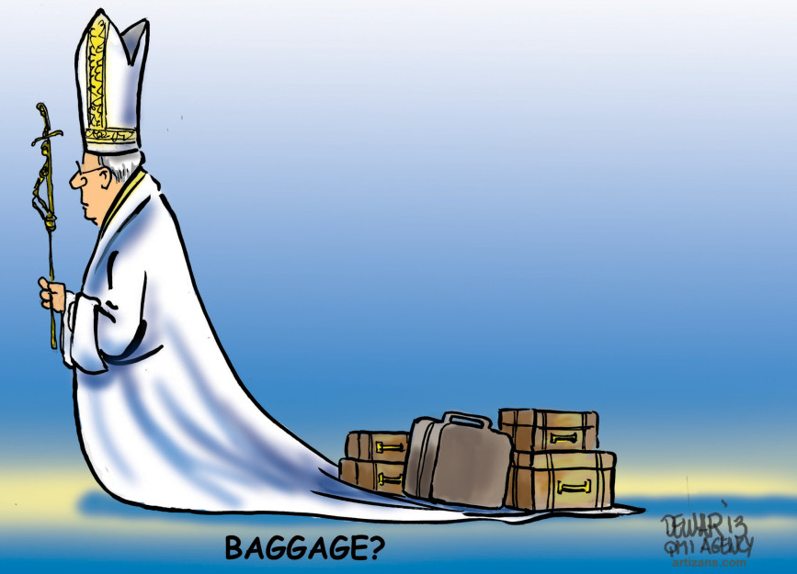
From Mission Field to the Mission Force
Graeme Mundine
Executive Officer
Aboriginal Catholic Ministry
Catholic Archdiocese of Sydney

Slide 2

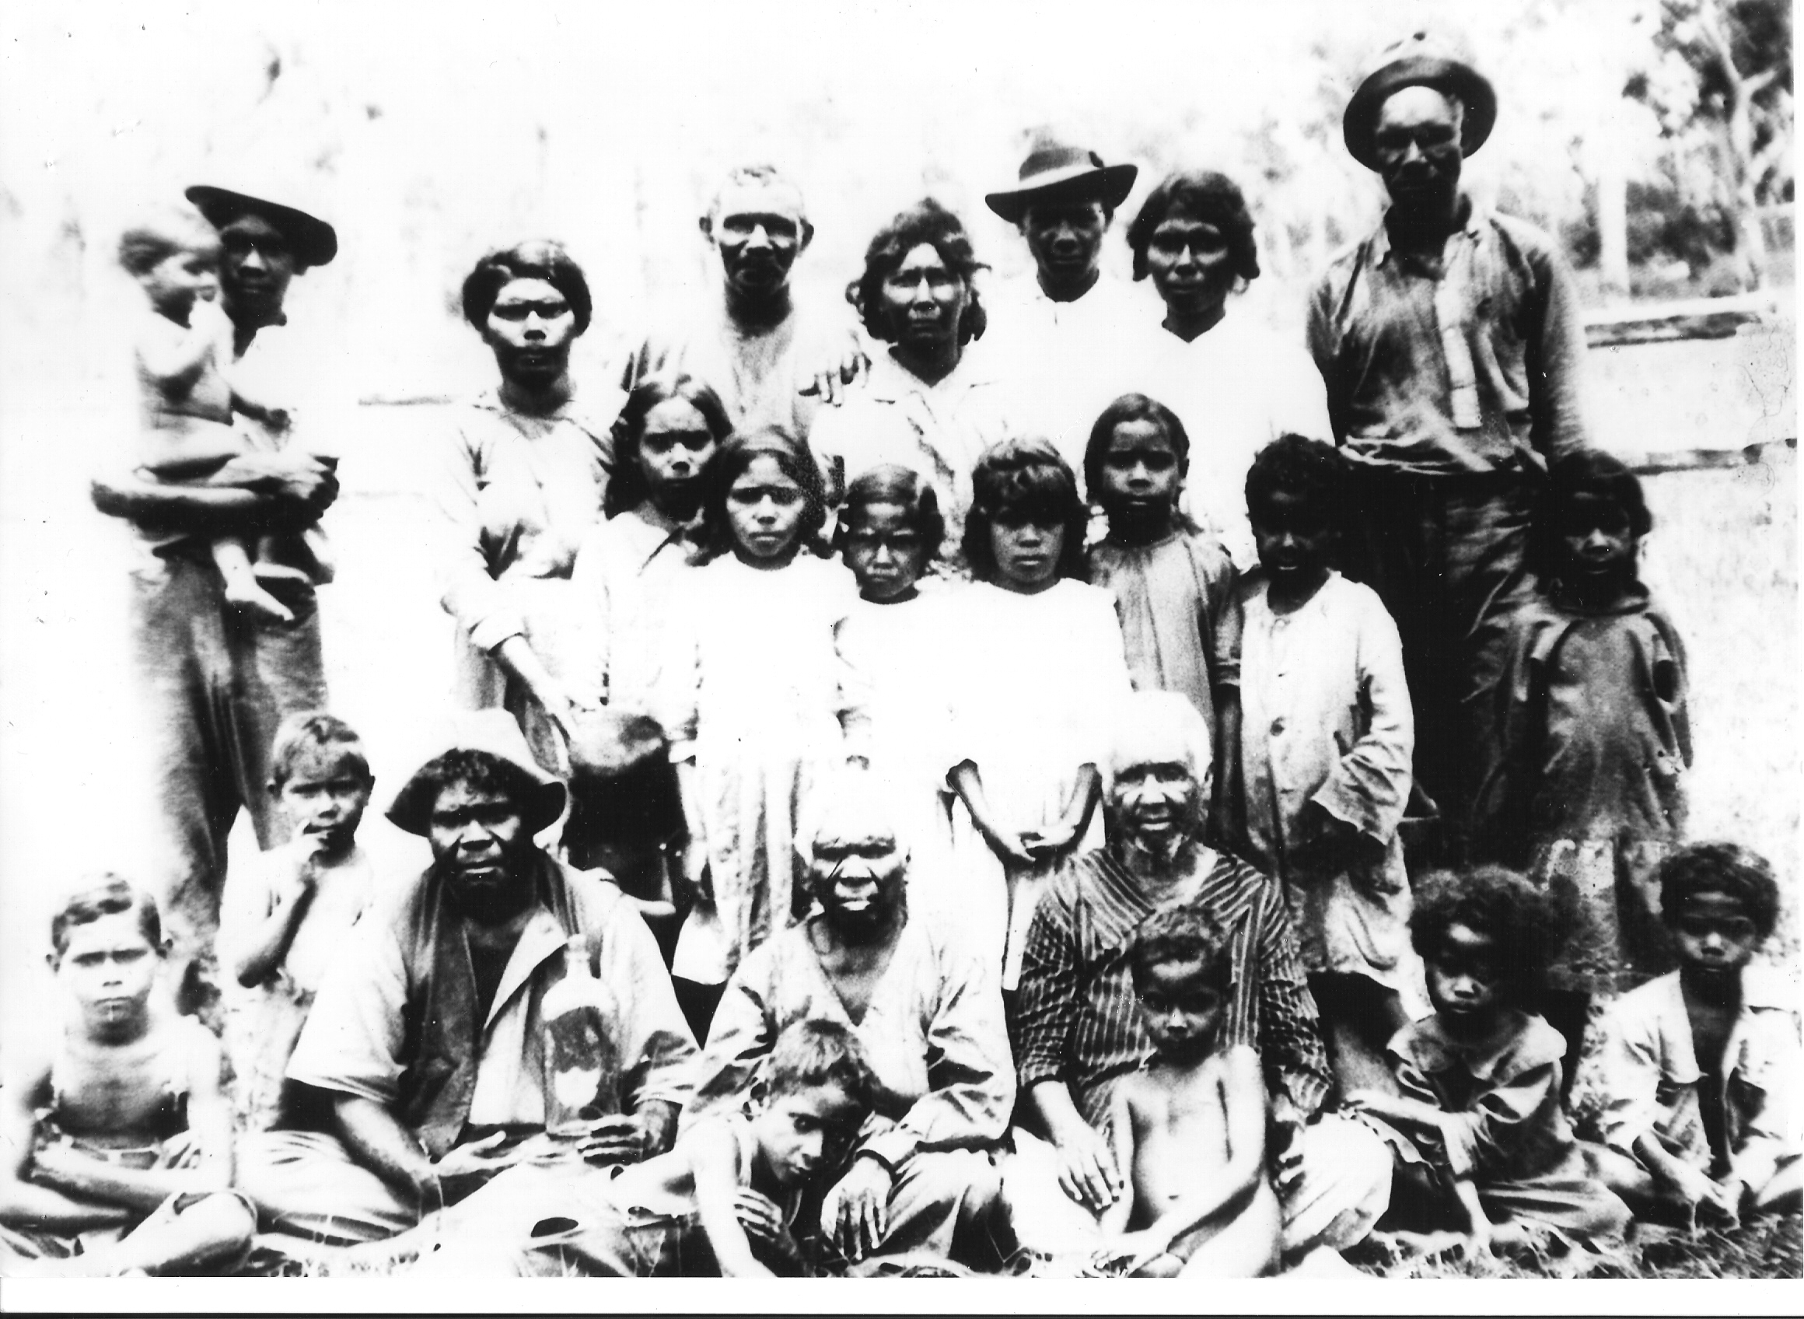

Acknowledgement of Country
Gadigal
I pay my respect to the Elders and Ancestors of the lands on which we stand today

Slide 3
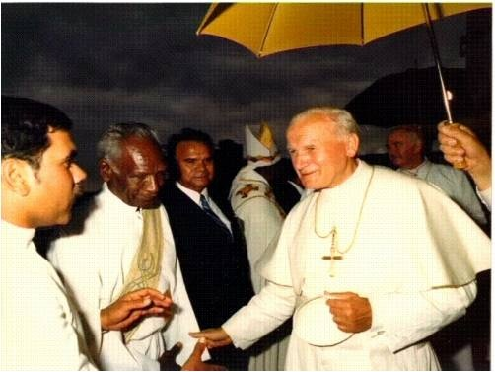
Where are we going today?
Mission today from an Aboriginal Catholic perspective
What is Inculturation?
The Australian context of Vatican II.
The Aboriginal experience of Inculturation?
The challenges for the future for Church.

Slide 4
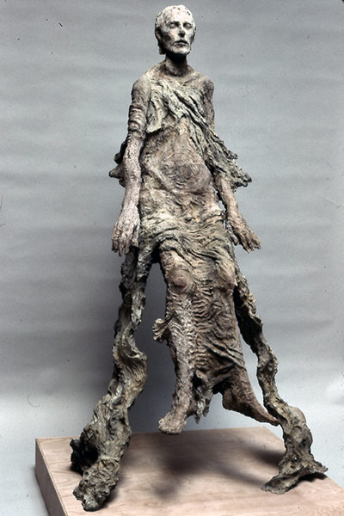
The Lazarus demand
‘Jesus cried out with a loud voice:
“Lazarus, come out!”
The dead man came out, his hands and feet bound with strips of cloth, and his face wrapped in a cloth.
Jesus said to them:
“Unbind him, and let him go.”’
John 11:43-44
Notes:
Jesus cried with a loud voice, “Lazarus, come out!” The dead man came out, his hands and feet bound
with strips of cloth, and his face wrapped in a cloth. Jesus said to them, “Unbind him, and let him go.”
(Gospel of John ch.11 vv.43-44)
Like Lazarus, too many Aboriginal people are “entombed”. They are entombed by poverty; by violence; by the effects of colonization; the legacy of missionaries; by exclusion; by racism; by more than 200 years of having land taken and culture trampled and by policies and practices from Governments, Churches and others which are designed literally, and metaphorically, to keep us bound and hidden, out of sight, behind the tomb stone.

Slide 5

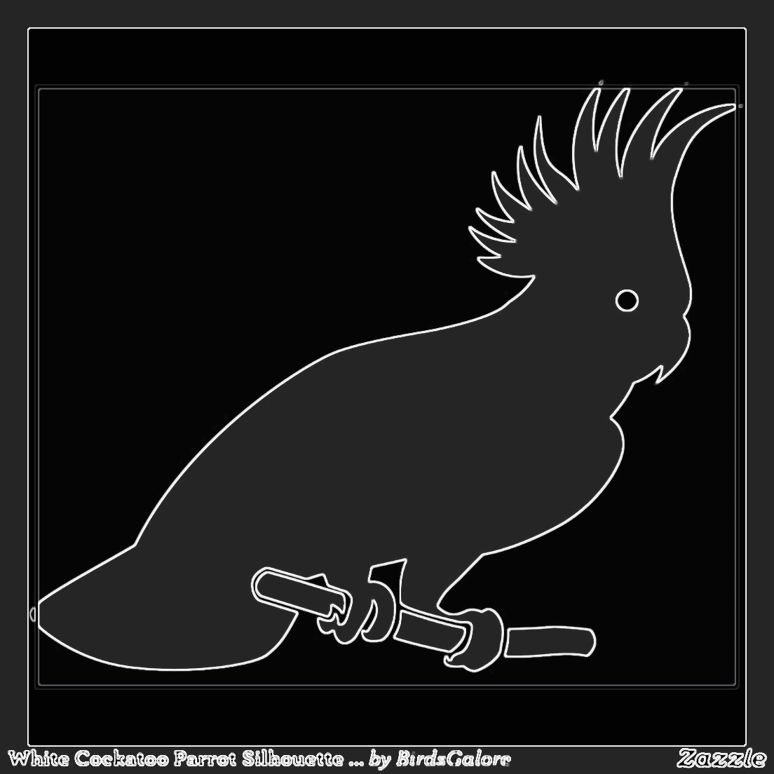
Black and White Cockatoo
Lutheran Pastor: Dr. George Rosendale.
Notes:
They were brothers.
One day the white cockatoo found the black cockatoo sitting under a shady tree looking angry and upset. 'What is wrong, brother?' 'I'm angry with dad because he made me black. Why didn't he make me like you? I'm going to change myself'. He went to his uncle's country and asked him for honey and clay. 'Get as much as you want, there's plenty there'. He got the clay and honey and went back home. He powdered the clay and rubbed honey all over himself and put the powdered clay on. He looked at himself and said, 'Now I look like my brother'. His grandpa got so angry with him that he called on the monsoon to bring rain. It washed all the clay off him.

Slide 6
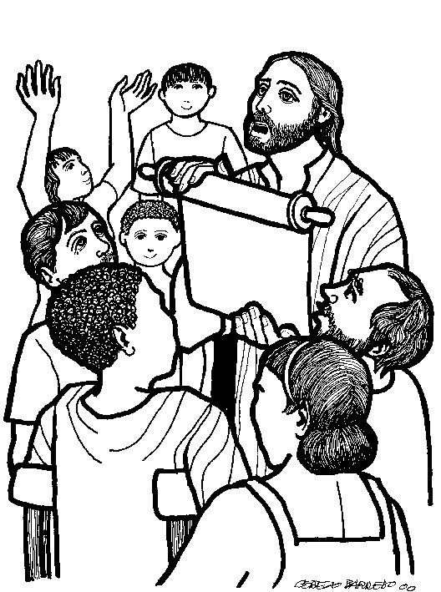
The spirit of the Lord is upon me, because he has chosen me to bring good news to the poor.
He has sent me to proclaim liberty to the captives and recovery of sight to the blind;
to set free the oppressed and announce that the time has come when the Lord will save his people.
Luke 3: v.18-19
Notes:
Is this not the essence of Jesus’ mission? It is no coincidence that these words were Jesus’ first words. They were words that guided him throughout his life. If you look at his life; he challenges the Pharisees and lawmen; he hung out with the sinners and spent his life healing those who were mentally, spiritually and physically sick. It says to us that we are to allow these people to be free from the things that bind them.
As Indigenous Christians we look to our Churches to walk with us as we throw off those things that oppress us. But often, we encounter imperialism and colonialism there too. It is not always our experience that Churches are truly opening eyes and hearts to Indigenous cultures and Peoples.
Last

Slide 7
Now let’s look at some of the history of the Church concerning Australian Aboriginal Peoples.

Slide 8
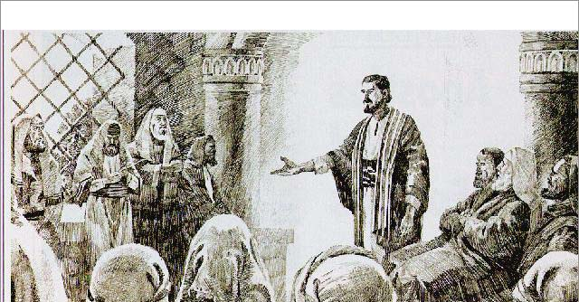
Council of Jerusalem
about 50AD
Acts 15
The council decided that Gentile converts to Christianity were not obligated to keep most of the Law of Moses, including the rules concerning Circumcism of Males.

Slide 9
Two styles of Mission or Evangelisation came from this.

Slide 10
One: here is the faith take it
or leave it
Two: plant a seed
and foster it to grow

Slide 11
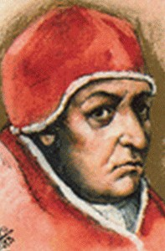
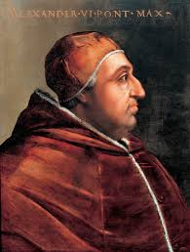
Doctrine of Discovery
The origins of the doctrine of discovery can be traced to Pope Nicholas V's issuance of the Papal Bull Romanus Pontifex in 1455. The bull allowed Portugal to claim and conquer lands in West Africa.
Pope Alexander VI extended to Spain the right to conquer newly found lands in 1493, with the Papal Bull Inter caetera, after Christopher Columbus had already begun doing so.
Arguments between Portugal and Spain (both Christian Countries) led to the Treaty of Tordesillas which clarified that only non-Christian (Pagan) lands could thus be taken, as well as drawing a line of demarcation to allocate potential discoveries between the two powers.

Slide 12
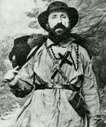
Observing the general and utter state of neglect, on the part of Catholics, in which the savages (‘selvaggi’) find themselves all over Australia, in whose immense extension nothing exists for them but the one and only Benedictine Mission of New Norcia, so harshly opposed by the one who should be its supporter and defender, several times it occurred to me that while the care of the souls of those savages is entrusted to the same ones to whom the care of the souls of the Europeans is entrusted, it will almost be miraculous if the true conversion and civilisation of only one savage is obtained. These will always remain neglected, because the care of the Europeans will absorb, as it has so far, the whole mind and resources of those [missionaries] and for the poor savages, i.e. for the legitimate owners of those same lands on which houses and churches are being built for the Europeans, there will never be one penny, due to them in justice rather than in charity; and I am so convinced of this that if it were possible to separate the two jurisdictions I would not hesitate for one moment humbly to propose it.
Bishop Salvado (Girola)
Notes:
Observing the general and utter state of neglect, on the part of Catholics, in which the savages (‘selvaggi’) find themselves all over Australia, in whose immense extension nothing exists for them but the one and only Benedictine Mission of New Norcia, so harshly opposed by the one who should be its supporter and defender, several times it occurred to me that while the care of the souls of those savages is entrusted to the same ones to whom the care of the souls of the Europeans is entrusted, it will almost be miraculous if the true conversion and civilisation of only one savage is obtained. These will always remain neglected, because the care of the Europeans will absorb, as it has so far, the whole mind and resources of those [missionaries] and for the poor savages, i.e. for the legitimate owners of those same lands on which houses and churches are being built for the Europeans, there will never be one penny, due to them in justice rather than in charity; and I am so convinced of this that if it were possible to separate the two jurisdictions I would not hesitate for one moment humbly to propose it.
Bishop Salvado (Girola)

Slide 13
Hopefully we have come a long way from the 1926 Mission Conference where this was said:
The natives when segregated, respond wonderfully to the teaching of Christianity, and much real religion is shown by them…To save the aborigines, body, soul and spirit demands that every individual native should have a chance to develop under the best conditions, and it is almost unanimously believed that this can only be obtained where segregation is possible, and where a religious basis for their lives is obtainable, it becomes apparent that the task that remains is to have every aboriginal on some Mission Station or other…This could be done with wild blacks, but is much more difficult to manage with those who are more or less civilized.
Australian Mission Society, Australia Facing the Non-Christian World, 15

Slide 14
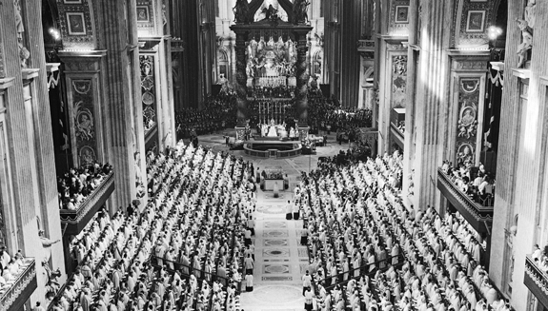
Vatican II: a rallying cry for Inculturation?
Vatican II contained a promise of radical hope for Aboriginal and Torres Strait Islander people.
The issues of culture and the nature of missionary work set out the Church’s thinking and led to deeper thinking and discussion on issues such as Inculturation.

Slide 15
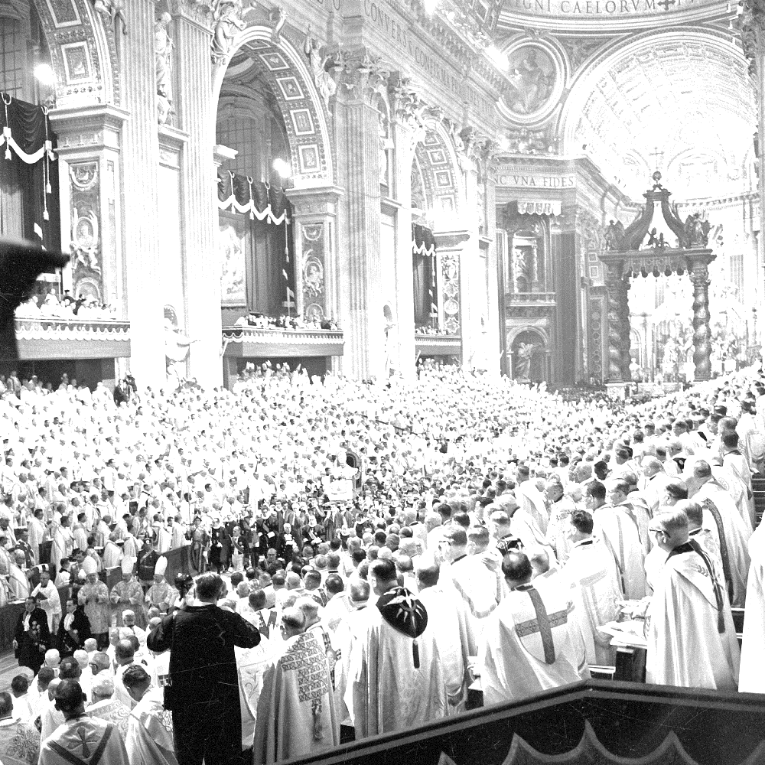
Culture and Gospel – the eternal issue!
In Gaudium et Spes the idea that culture and Gospel can be in communion with each other was addressed.
  The Church sent to all peoples of every time and place is not bound exclusively and indissolubly to any race or nation, nor to any particular way of life or any customary pattern of living, ancient or recent, faithful to her own tradition and at the same time conscious of her universal mission, she can enter into communion with various cultural modes to her own enrichment and theirs. G.S. 58
Notes:
G.S - Gaudium et Spes - The joys and hopes, the grief and anguish of the people of our time, especially of those who are poor or afflicted, are the joys and hopes, the grief and anguish of the followers of Christ as well. The Pastoral Constitution on the Church in the Modern World, was one of the four Apostolic Constitutions resulting from the Second Vatican Council. The document is an overview of the Catholic Church's teachings about humanity's relationship to society, especially in reference to economics, poverty, social justice, culture, science, technology and ecumenism.

Slide 16
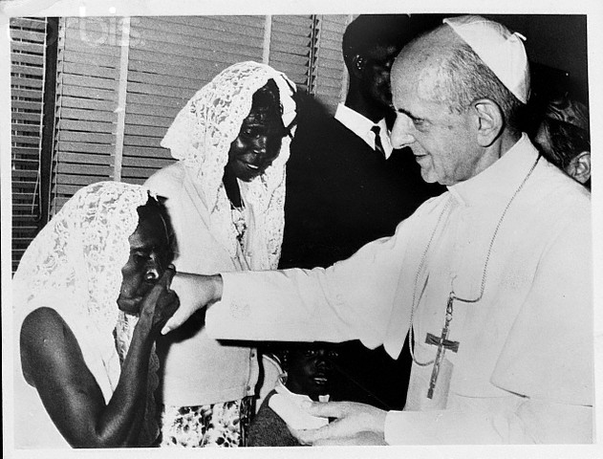
Recognising culture
The message of Vatican II was clear - the Church should not force an alien culture on anyone, but rather should recognise what is already there and:
Let them share in cultural and social life by the various exchanges of human living let them be familiar with their national traditions, gladly and reverently laying bare the seeds of the Word which lie hidden in them. AG 11
Notes:
Ad Gentes - "To the Nations," Decree on the Missionary Activity of the Church
Ad Gentes focused on the factors involved in mission work. It called for the continued development of missionary acculturation. It encourages missionaries to live with the people they are attempting to convert, to absorb their ways and culture. It encourages the coordination of mission work through agencies and the cooperation with other groups and organizations within the Catholic Church and other denominations

Slide 17
How should we approach culture?
People going out to spread the Word should...
[K]now the people among who they live and should establish contact with them. Thus they themselves can learn by sincere and patient dialogue to understand what “treasures a bountiful God has distributed among the nations of the earth but at the same time, let them try to illume these treasures with the light of the Gospel to set them free, and to bring them under the dominion of the God their saviour”. AG 11
Notes:
Ad Gentes - "To the Nations," Decree on the Missionary Activity of the Church

Slide 18
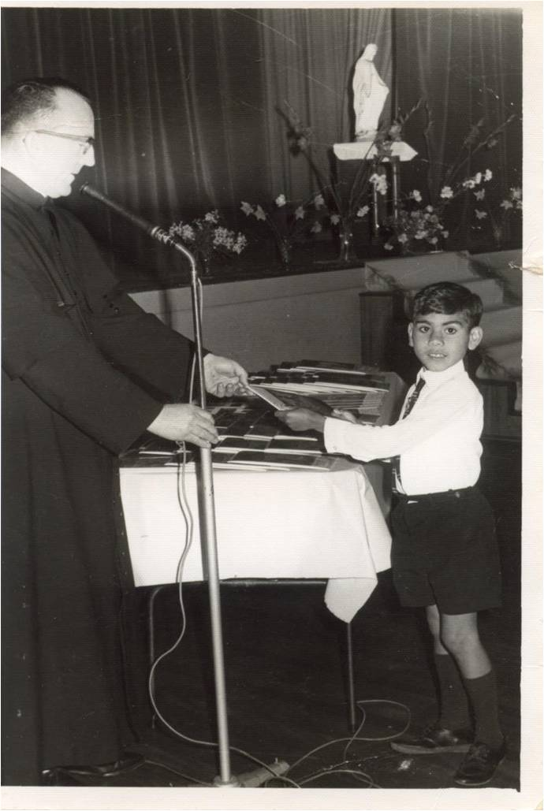
Assumptions
The language of the documents are still very much orientated to talking about missionaries who are from one culture going into another – rather than recognising that Aboriginal people were, and are, predominantly Christian and have been for over 170 years in some places.
Aboriginal people are Catholic too!
Notes:
1843 first catholic mission stradebroke island
1846 two Aboriginal Boys taken to Europe to train as missionaries to their own Peoples.

Slide 19

Development of thinking on Inculturation since Vatican II.
Pope John Paul II explained Inculturation signifies “an intimate transformation of the authentic cultural values by their integration into Christianity and the implantation of Christianity into different human cultures”.
John Paul II, encyclical, Redemptoris Missio Dec 7, 1990, No 52. AAS 83 (1991) 300
Notes:
Redemptoris Missio - Mission of the Redeemer - subtitled On the permanent validity of the Church's missionary mandate
Two way Learning <->

Slide 20
What does the Church mean by Inculturation?
…by Inculturation, the church makes the Gospel incarnate in different cultures and at the same time introduces peoples, together with their cultures, into her own community. On the one hand the penetration of the Gospel into a given socio-cultural milieu “gives inner fruitfulness to the spiritual qualities and gifts proper to each people…strengthens these qualities, perfects them and restores them in Christ.
On the other hand, the church assimilates these values, when they are compatible with the Gospel, to “deepened understanding of Christ’s message and give it more effective expression in the liturgy and in many the many different aspects of the life of the community of believers”.
Instruction: Inculturation and the Roman Liturgy Congregation for Divine Worship and the Discipline of the Sacraments, March 29, 1994 4th Instruction.
Notes:
After Vatican II there have been five Instructions on how to interpret the Councils document on liturgy Sacrosantctum Concilium. The Fourth instruction for the right application of the Conciliar Constitution on the Liturgy issued on March 29, 1994.
Give examples: Part 1> Smoking, Water Ceremonies. Aboriginal Our Father, Hail mary, Lamb of God, Art etc
Part>2 Social justice statements . Understanding about Land. But they can’t accept Part>1

Slide 21
What does the Church mean by Inculturation?
In 1969 Pope Paul VI addressed African Catholic Bishops and stressed that “First, your Church must be first of all Catholic” but he went on to say:
  The expression, that is, the language and mode of manifestering this one Faith, may be manifold: hence, it may be original, suited to the tongue, the style, the character, the genius, and the culture of one who professes this Faith.
Pope Paul VI Address to the bishops of African meeting in Kampala, Uganda, July 31 1969 as quoted in George p52.
Notes:
Oblate Cardinal Francis George - "Inculturation and communion” probably of the said authorities on Inculturation. Cardinal archbishop of Chicago USA

Slide 22
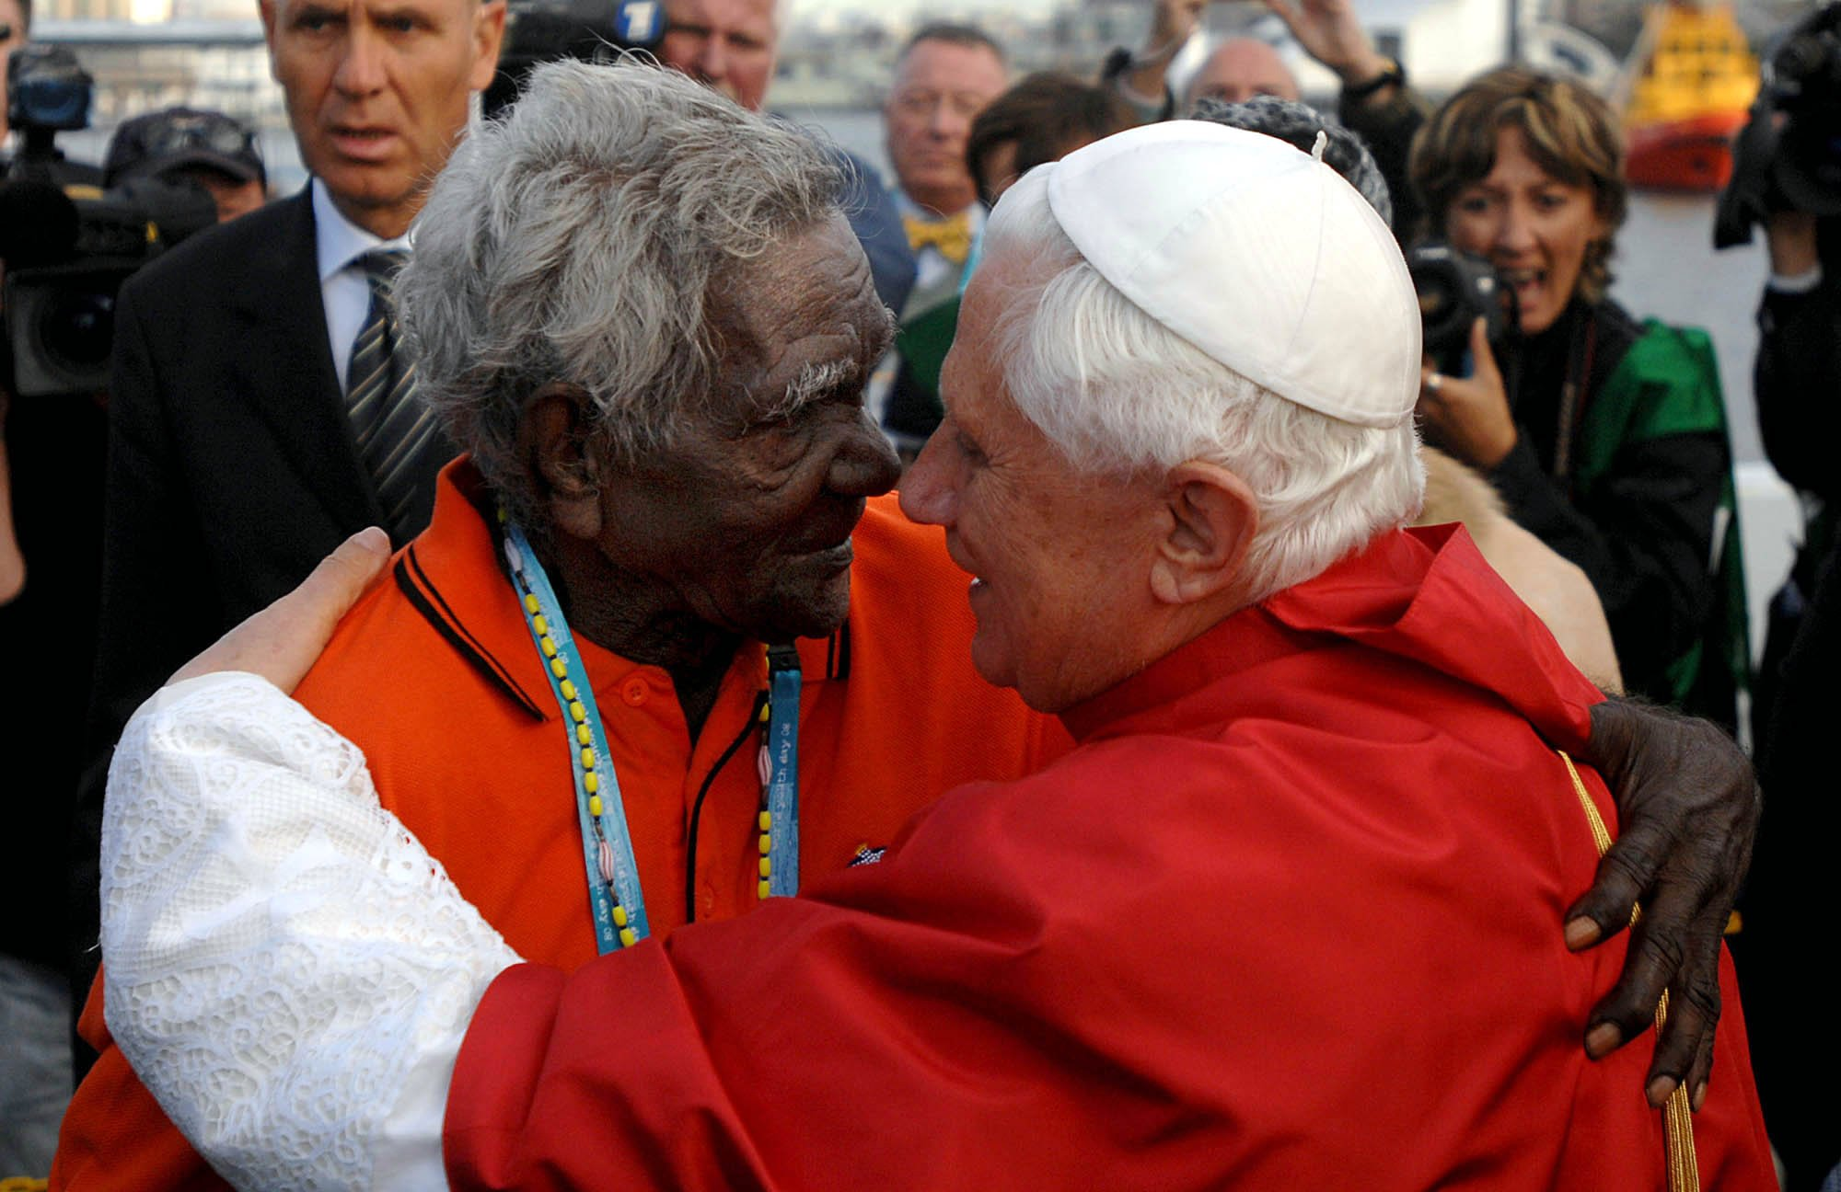
Who can Inculturate?
The work of Inculturation will usually be done by those to whom the new forms for expressing the substance of the faith are co-natural, “part of their own cultural patrimony”
  Francis George commenting on the General Synod 1977 (first official use of the term Inculturation).
How does this work in Australia?
Notes:
Oblate Cardinal Francis George - "Inculturation and communion” probably of the said authorities on Inculturation. Cardinal archbishop of Chicago USA

Slide 23
The problem for Australia
Inculturation has at its core the understanding that this process can only be authentic when done by people of the culture.

Slide 24
The problem for Aboriginal Catholics is...
In Australia all Bishops and Priests are non-Indigenous people.
Culture can only be truly integrated into the life of the Church when those who are in positions of power and decision making are also of the culture.
Otherwise every attempt at Inculturation is perceived through the lens of the dominant culture.

Slide 25

The problem for Australia
The Australian Church hasn’t come to understand - “the message that we proclaim always has a certain cultural dress, but we in the Church can sometimes fall into a needless hallowing of our own culture, and thus show more fanaticism than true evangelizing zeal”. EG 117
www.catholicmission.org.au

Slide 26
The problem for Australia
As the Rev. Dr. Graham Paulson says the tendency is to start with principles
  ...already shaped within a western denominational enculturation – and then asking what they mean for Indigenous people…There has been very little theological reflection that begins from an Indigenous mindset and engages more directly with biblical theologies and practices”. G. Paulson, Towards an Aboriginal Spirituality, Pacifica 2006 19

Slide 27
Has Vatican II helped Aboriginal Catholics?
Steps forward...
  1973 Eucharistic Congress – Missa Indigena.
  1986 The Pope John Paul II speech to Aboriginal peoples.
  Some limited use of Aboriginal symbols and songs in liturgies.
  Aboriginal Catholic Ministries and National Aboriginal and Torres Strait Islander Catholic Council (NATSICC).
  Aboriginal Deacons

Slide 28
Challenges
Racism
New translation liturgy – less likely to allow things such as acknowledgements, smoking ceremonies, water ceremonies, hymns, prayers etc. – Contradicts the teaching of Vatican II?
We need to get permission from each Bishop.
Priests are often blocks.
Culture is suppressed not supported.
Formation or Education is still biased to Western way of doing things
Education system not fully grasping our cultural perspectives
Notes:
Although in in 1973 permission has been granted by the ACBC for the use certain things the new liturgy is in another world

Slide 29
What’s the future?
Need to engage in true dialogue promised by Vatican II
Non-Indigenous Catholics need to stop treating us like they are more Catholic than us and they “allow” us to be part of the church.
Non – Indigenous people need to stop speaking on our behalf and excluding us from the power structures. We need to be directly at the table with the decision makers.
Non-Indigenous clergy and Bishops need to work with us to incorporate our cultural practices and symbols into liturgies.
Non-Indigenous Catholics should be examining whether church as it is today is a truly Australian church or have they accepted another culture along with their faith.

Slide 30
What’s the future?
Aboriginal people need to consider:
  Aboriginal priests (Elders)?
  An Aboriginal Rite? Aboriginal ordinariate? Personal Prelature?
  Other structures that allow us to be both Aboriginal and Catholic without all the gate keeping.
  As Pope John Paul II said to us:
  “You do not have to be people divided into two parts, as though an Aboriginal had to borrow the faith and life of Christianity...” JP11 Alice Springs 29 Nov 1986

Slide 31
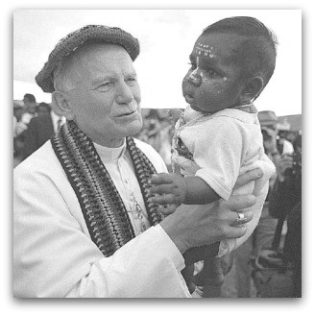
What’s the future?
“Take this Gospel into your own language and way of speaking; let its spirit penetrate your communities and determine your behaviour towards each other, let it bring new strength to your stories and your ceremonies. Let the Gospel come into your hearts and renew your personal lives. The Church invites you to express the living word of Jesus in ways that speak to your Aboriginal minds and hearts. All over the world people worship God and read his word in their own language, and colour the great signs and symbols of religion with touches of their own traditions. Why should you be different from them in this regard, why should you not be allowed the happiness of being with God and each other in Aboriginal fashion? ”
(Pope John Paul II, Alice Springs, 29th Nov 1986)

Slide 32
We are part of the mission force.
We are equal partners in the creation of the community of church of the future. We need the mainstream church to listen - not to impose; to learn - not to dictate. Open your hearts and minds to what Indigenous Peoples offer and then we can walk together to live the life that Christ has called each and every one of us too.

Slide 33
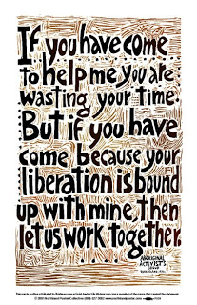
What’s the future for you?
Notes:
Lilla Watson

Slide 34
This talk is taken from three papers I have published elsewhere.
The Mission field to the Mission Force
http://www.ncca.org.au/files/Natsiec/Illuminations_Edinburgh_2010.pdf
2. Leadership for Mission with Aboriginal Peoples.
http://catholicmission.org.au/educationformation/the-francis-effect-living-the-joy-of-the-gospel
3. Aboriginal Inculturation of the Australian Catholic Church
http://www.maneyonline.com/doi/abs/10.1179/1476994814Z.00000000024

