Slide 1
WHERE THERE IS NO VISION THE PEOPLE PERISH
Proverbs 29:18

Slide 2
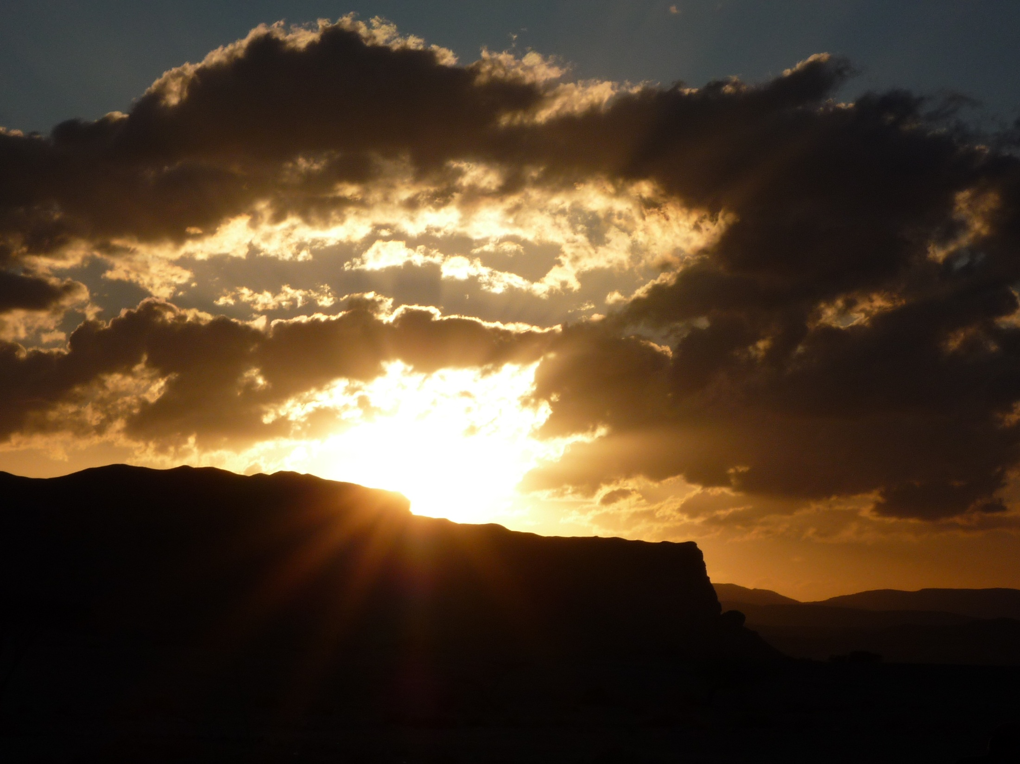

Slide 3

Not only is another world possible,
she is on her way.
On a quiet day
I can hear her breathing!
Arundhati Roy, The God of Small Things

Slide 4
“Today amid so much darkness we need to see the light of hope and to be men and women who bring hope to others,' he said. 'To protect creation, to protect every man and every woman, to look upon them with tenderness and love, is to open up a horizon of hope.”
Pope Francis, inaugural Mass in St Peter’s Square on 19 March

Slide 5

Stand at the crossroads and look
Ask for the ancient paths
Which was the good way?
Walk in it!
And you will find rest for yourselves.
Jeremiah 6:16
Jeremiah 6:16

Slide 6

The Divine Mission

Slide 7
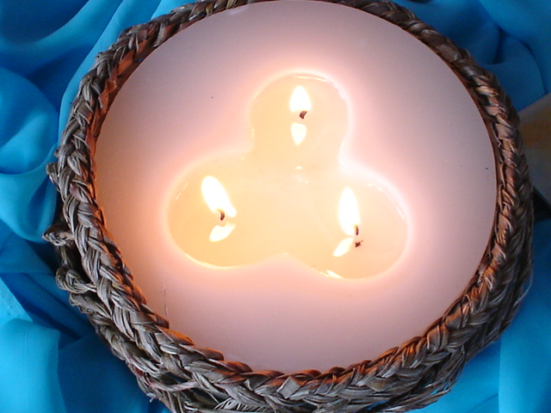
We make our life
an encounter with God-Trinity
God-in relationship
and become contemplative witnesses
in a pluralistic world.

Slide 8
The Divine Mission can never be fully contained or expressed in words or images.
The Mission of the Trinity is expansive and unrestrained, and expresses for us the universality of mission.

Slide 9

We are drawn into an incredible Mystery of
Divine Relationship

Slide 10
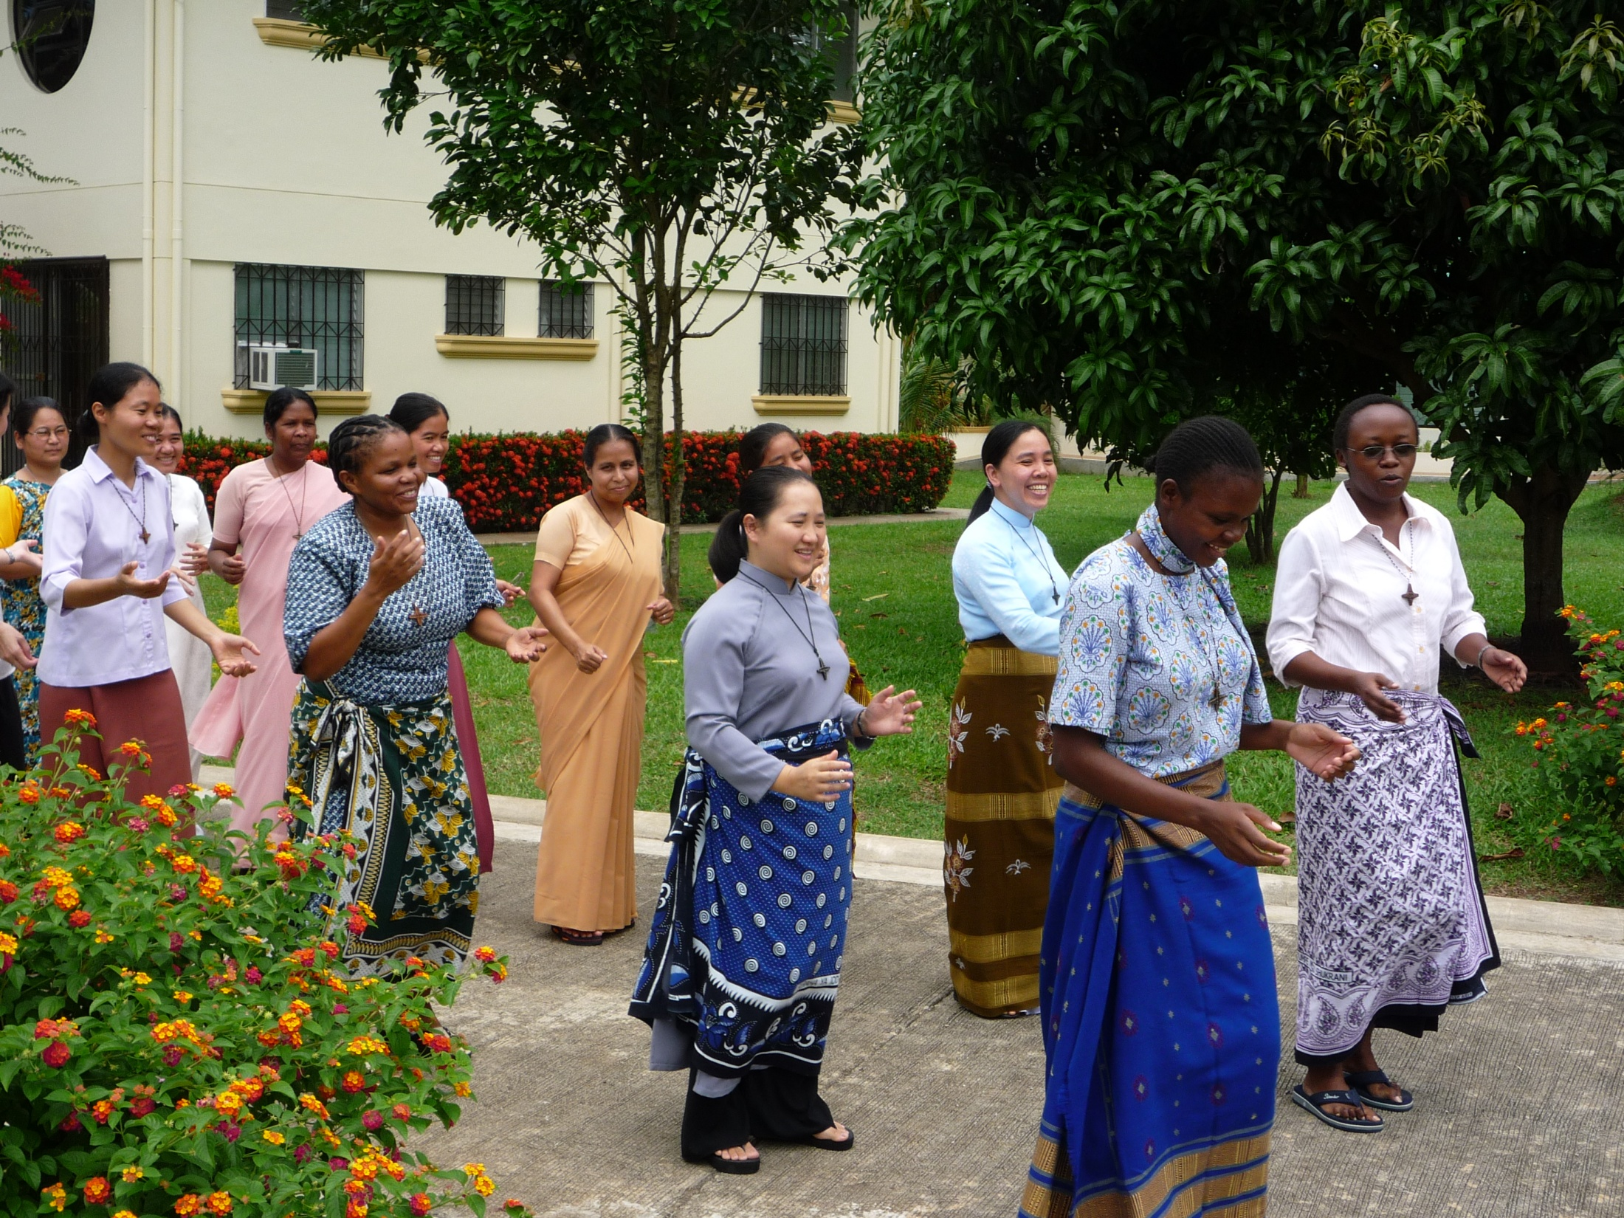

Slide 11


Slide 12

Prophecy and Visioning
To be attentive to the Spirit; to hold diversity lightly, to embrace differences of age, culture, ministries, countries, languages and experience; to engage the imagination
in order to shape a common vision for mission;

Slide 13

Pastoral Care
The role of leadership to have confidence in the young; to encourage and motivate the seasoned; to listen compassionately to the tired, the sick and the disillusioned; to draw inspiration and strength from their wisdom of the elderly and support them in their frailty and their final journey!

Slide 14
Administration and Stewardship
Strategic planning, ensuring the on-going training of personnel.
In an increasingly complex global financial reality, engaging the expertise of lay advisors.
Striving for transparency and best practice in all our undertakings.

Slide 15
The Role of the Prophet
The role of the prophet in the Scriptures critiquing society and calling the people to fidelity to their covenant with God, to restoring right relationships, and insisting on compassion and justice for the poor, the stranger, the widow and the orphan.

Slide 16

One of the principal tasks of leaders in mission is to be attentive to the prophetic voices - within the members, among the people with whom we journey in mission, and within society. Leadership must encourage “good dreaming”.

Slide 17
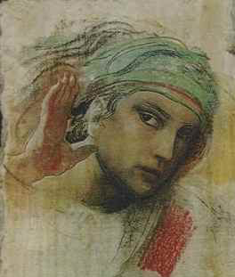
“Be ever attentive to the “Whisperings of Grace!”
“Obedience”
Benedictine Monastery
Montecassino, Italy

Slide 18
Leaders must be attentive, listening and observing what the people need, and a good knowledge and awareness of the skills, experience, and potential of the members of the institute or organization, in order to be able to articulate a clear vision of mission and to define the pathways to achieve that vision.

Slide 19
This element of the call to be a missionary is primarily a call to be aware always of the presence of God in our being, in our midst, in our universe, and in ‘what God is revealing’. This awareness … comes when we affirm that God is with us,, and then with patience and discipline, listen to a God who whispers!”
Sinvalon, John C. MM. God’s Mission and Postmodern Culture. The Gift of Uncertainty (Maryknoll: Orbis Books, 2012). p76

Slide 20

The God who “whispers!”

Slide 21
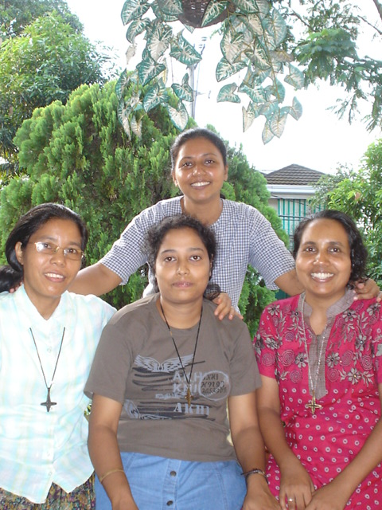
Bangladeshi Sisters studying Theology, Sociology and Educational Management in Manila

Slide 22
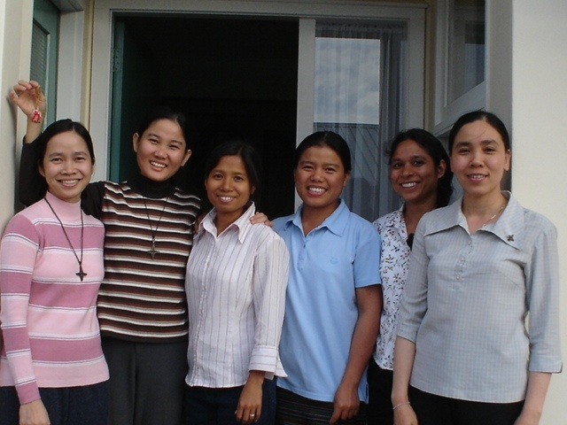
Vietnamese, Bangladeshi and Burmese Sisters studying in New Zealand

Slide 23
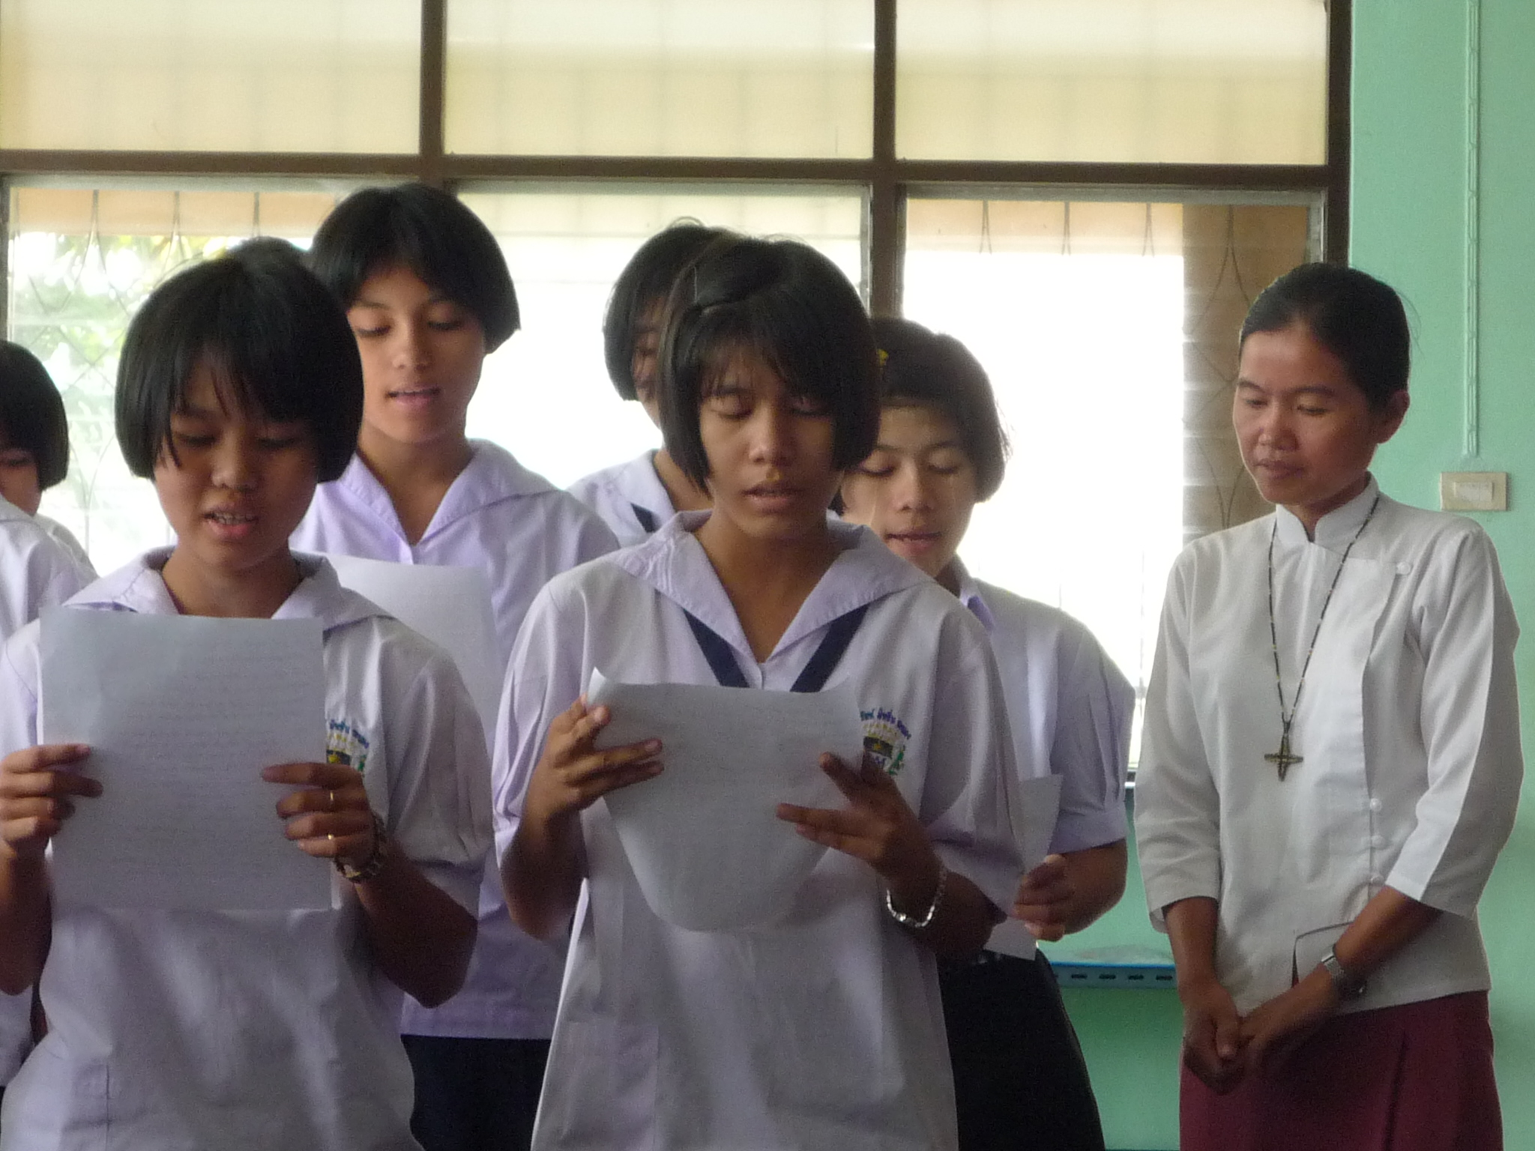
Collaborative Mission among Burmese migrants with Marist Fathers in Ranong, Thailand

Slide 24
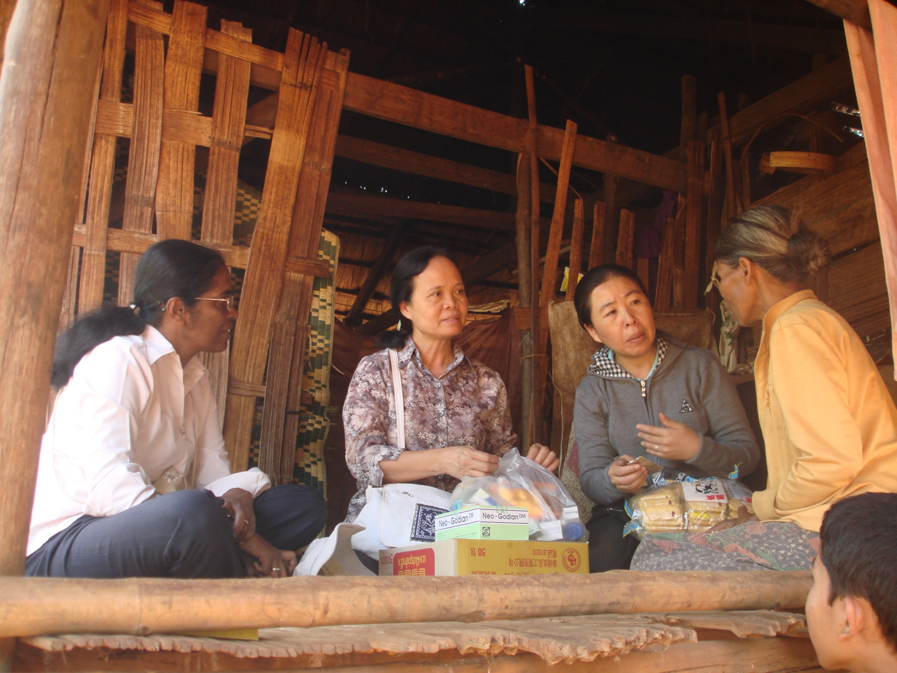
Visiting the sick, Pakse, Laos

Slide 25
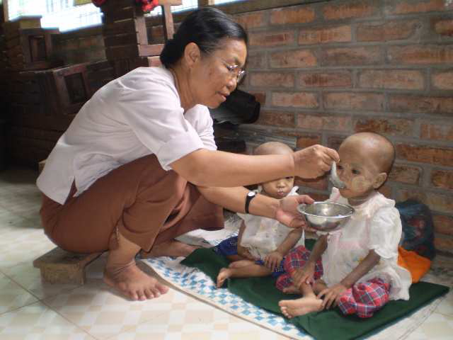
Orphan children with HIV, Myanmar border

Slide 26
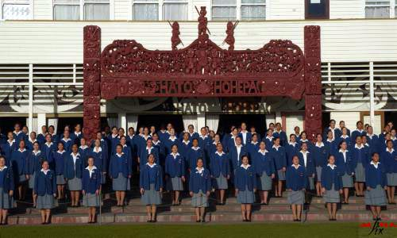
St Joseph’s Maori Girls’ College

Slide 27
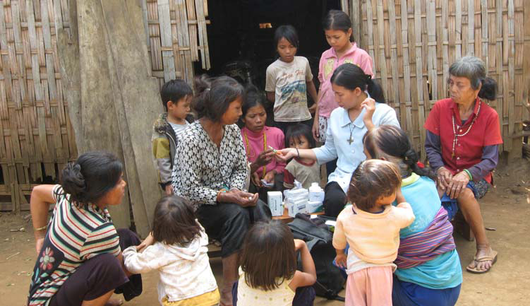
Montagnard People, Vietnam, Health Ministry

Slide 28
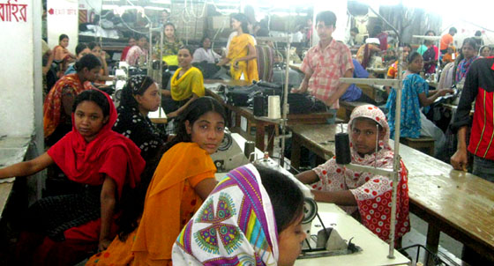
Migrant Factory Workers, Bangladesh

Slide 29
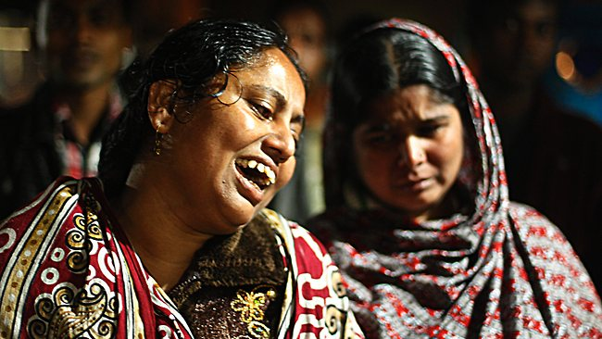
Bangladesh factory fire kills more than 300, hundreds more missing!

Slide 30
ANTI-TRAFFICKING
The trafficking of women and children, an abhorrent abuse of our time, has created new forms of slavery, affecting women from parts of Asia, and Eastern Europe as well! Those who are most susceptible are women and girls from impoverished and low income households in rural areas and urban slums, especially women labourers or scavengers, and in other low status work and services. Ethnic minorities, indigenous people, hill tribes, refugees, and illegal migrants are also at risk, as are people who are illiterate of have limited education.

Slide 31
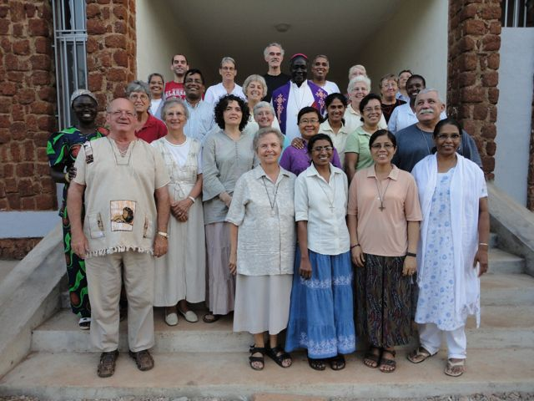
SOLIDARITY WITH SOUTH SUDAN
There are currently 25 missionaries in SSS from 16 different religious orders and 14 nationalities
There are also 2 participants from VMM (Ireland)

Slide 32
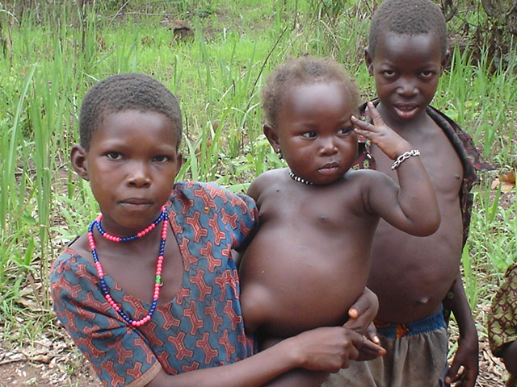

Slide 33
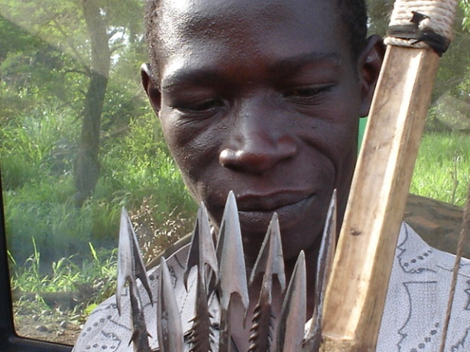

Slide 34
SOLIDARITY WITH SOUTH SUDAN (SSS)
These missionary men and women from many nations are courageous and committed. This ground-breaking initiative on the part of the UISG and USG, at the request of the Bishops of South Sudan, is an enormous contribution towards reconstruction of a new country and society. It is also imaging new approaches to mission among religious and lay volunteers.

Slide 35
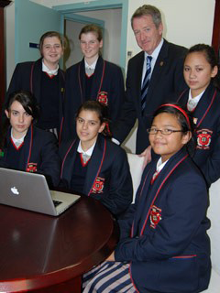
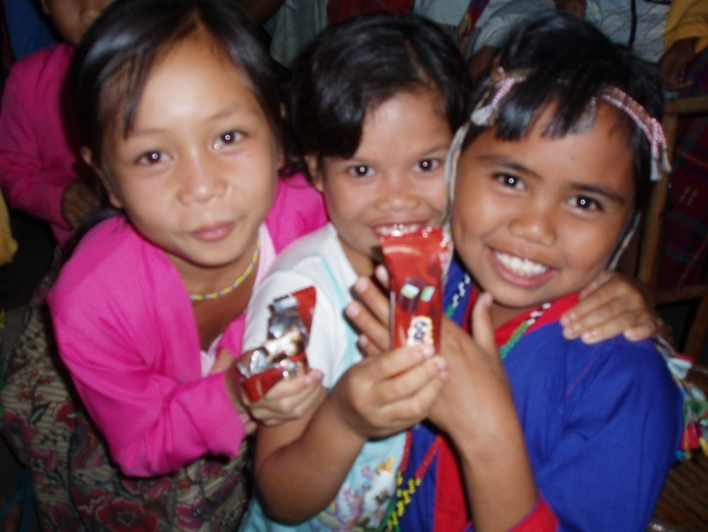
Sacred Heart College Oakleigh, Melbourne: Partnership with Notre Dame Hostel for Manobo Girls, Kulaman Southern Philippines

Slide 36


Slide 37


Slide 38
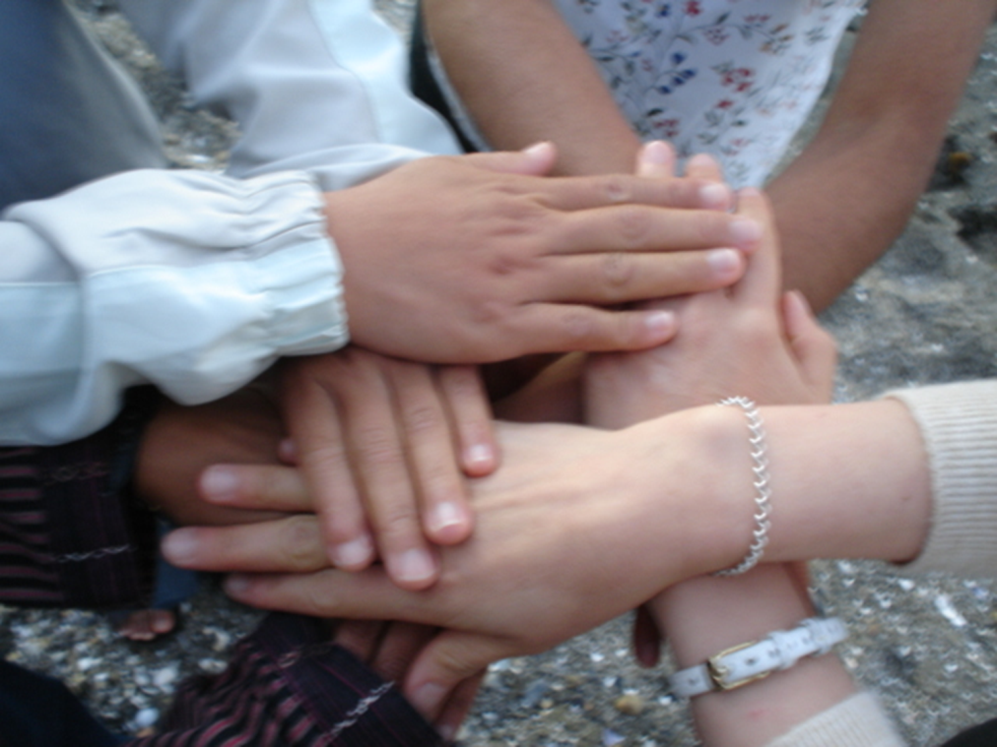
Multicultural Communities
Wherever we are engaged in mission today, locally or internationally, the context is multicultural.
In our communities the ideal we strive for is to nurture relationships that are life-giving and based on a spirit of
trust, cultural
sensitivity, mutual
respect, appreciation
and encouragement.

Slide 39


Slide 40
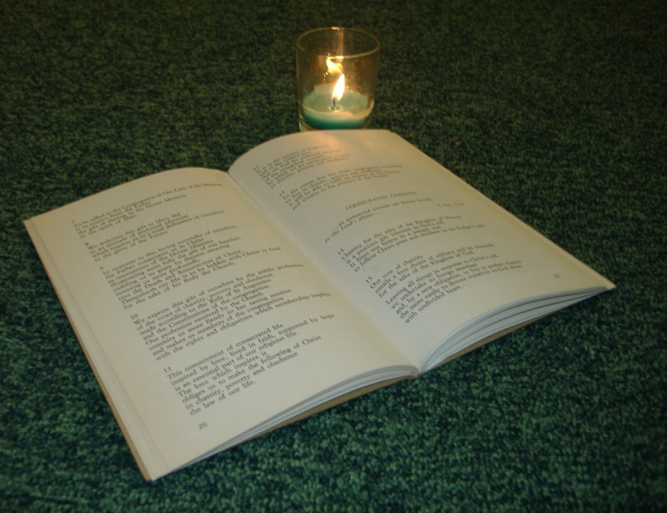
Rewriting Constitutions
What has been extraordinary is the unanimity of thought and expression coming from such amazingly diverse experience! It has been a moment of grace, a maturing of respect for the other, a blossoming of community relationships, as well as a renewed passion for mission.

Slide 41
Professionalism
Stewarding Resources
Complex financial challenges
Strategic Planning
Best Practice
Belief in Divine Providence!
“We recognize that humans do not so much think their way into new ways of living, but live their way into new ways of thinking and creating! “ We Are One, We Are Love
RNDM 2008 Chapter Document

Slide 42


Slide 43

Human beings do not so much think their way into new ways of living but live their way into new ways of thinking and creating

Slide 44


Slide 45
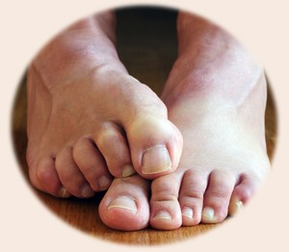
Preparation for Leadership
Reluctance to accept leadership
Fear of unknown (or known!)
Loss of meaningful ministry
Difficulties in moving back into ministry after terms of leadership
Too “young”
Too “old”

Slide 46

Leaders are expected to be superhuman perfect people! An impossible dream! Leaders must be dreamers, visionaries, diplomats, counsellors, strategists, teachers, confessors, healers and managers! They have to multi-task and keep a thousand and one things before their mind. They need good memories to remember names, faces, places of mission, and be able to forget personal hurts conflicts and betrayals sometimes!

Slide 47
They must be sensitive and compassionate, have broad shoulders to accept criticism, cope with confrontation, and be willing to try and resolve conflicts. They need a sense of humour and be able to laugh at themselves! They must take courageous and unpopular decisions, and be ready to stand by them. There will be times when they have to let go an idea they hold dearly, or they may be obliged to compromise for the sake of a greater good!

Slide 48

They will know moments of overwhelming joy and a sense of accomplishment. But they will also experience corresponding moments of great loss, loneliness and desolation. Friends may not always stand alongside them. They will become discouraged and disillusioned. They will please some of the people some of the time, but definitely not all of the people all of the time.
They need gifts of
inner strength and
resilience, humility
and simplicity, the
readiness to admit,
“I was wrong!”, and
to say, “I’m sorry!

Slide 49
Leaders need time to rest, to lick wounds in order to be able to ponder and wonder again! I have a favourite quote from Etty Hillesum that for the past 10 years I have on the board in front of my computer. It keeps me motivated: There are moments when I feel like giving up or giving in, but I soon rally again, and do my duty as I see it to keep the spark of life inside me ablaze!”

Slide 50

LEADERS
They
are us
you know,
our leaders;
finally
leading
ourselves
as us:

Slide 51

Who we really
are:
More perfect
for
our imperfections:
Unconditionally
& forever
loved
human beings
Alice Walker: extract from Loving Our Leaders in Hard Times Require Furious Dancing

Slide 52
HEARTS ON FIRE!
THE LEADERSHIP OF WOMEN
IN THE SCRIPTURES

Slide 53
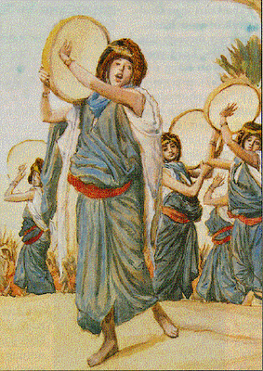
MIRIAM
Miriam was one of the leaders of the opposition against Pharoah. She played a major role in the Exodus, inspiring mena and women to celebrate in joy and freedom after 200 years of slavery

Slide 54
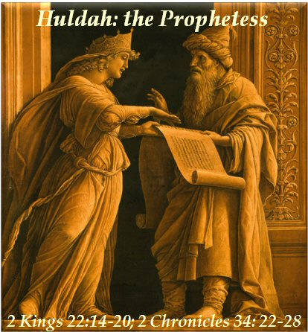
HULDA
According to Midrash, Hulda had a school for women in Jrusalem around the time of Jeremiah. Hulda played an important role in the spiritual renewal of the Hebrew people under King Josiah. When the Book of the Law was rediscovered in the Temple, ca 622BC, the King’s advisors approached Hulda to ask for wisdom, and to authenticate the Book.

Slide 55
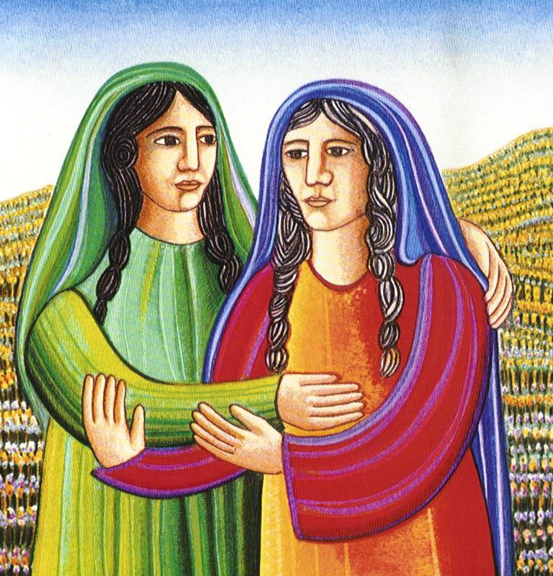
RUTH
Ruth is a woman of relationship. She is an icon of what it means to be a woman, to live under the impulse of the Spirit, to be a creative part of God’s creative power, courageous, risk-taking, stepping out into the unknown, going beyond the call of duty. She is a woman of deep faith, she can be decisive when needed and consults when she is unsure. She is not afraid of hard work. Right relationships are vital for her. She is a true friend and a faithful companion.

Slide 56
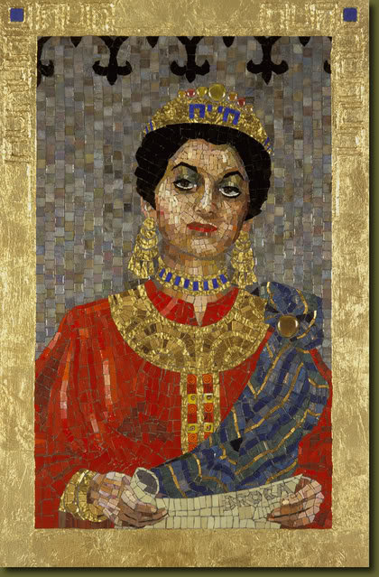
QUEEN ESTHER
Esther is an icon of integrity and insight. She is a wisdom woman who can see and imagine things through a different lens. She is compassionate. She is self-confident and comfortable in a different cultural context. She doesn’t panic. She is a negotiator, a peacemaker. She practises what she preaches and because of this is able to bring other people on board with her visions and plans. Her wisdom and bravery saved her people from destruction and death. Her uncle, Mordecai observed: Who knows, but that it was for a time like this that you obtained royal dignity. Esther, 4:14

Slide 57
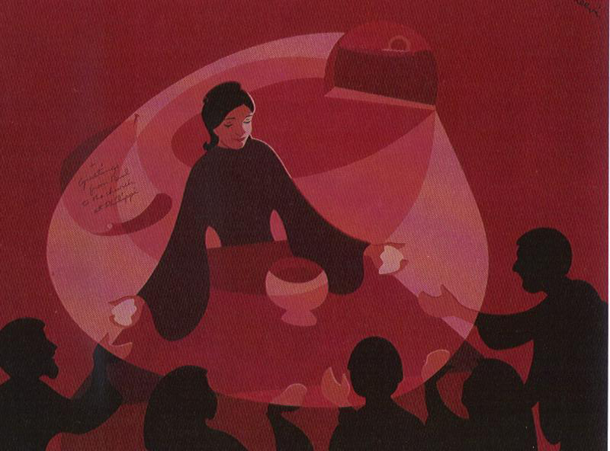
LYDIA
Lydia is an icon of the woman of faith, the seeker of truth. She is strong-minded and self-directing, a woman of substance who attracts and influences others for good. She is a woman or prayer, is spontaneous, assertive, hospitable and passionate. She is deeply committed and commands respect.

