Slide 1
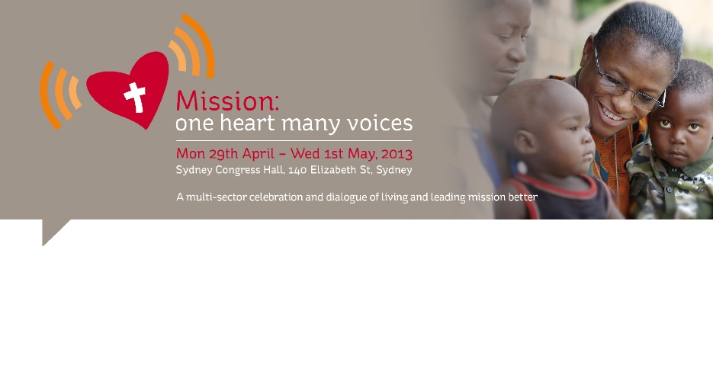
Mission in Dialogue
Dr Edmund Chia
Rev Dr Patrick J McInerney

Slide 2
Mission is Complex
“Mission is thus presented in the consciousness of the church as a single but complex and articulated reality.” (DM, 13) [1984]
  Simple presence and living witness
  Service of mankind (sic!) and all forms of activity for social development and for the struggle against poverty and the structures which produce it
  Liturgical life, prayer, contemplation
  Interreligious dialogue
  Announcement and catechesis, proclamation, consequences for life and culture.

Slide 3
Mission is Complex
Paths of Mission, Chapter V, Redemptoris Missio [1990]
  Witness (42-43)
  Initial Proclamation (44-55)
  Conversion and Baptism (46-47)
  Forming local churches (48-50)
  “Ecclesial Basic Communities” (51)
  Incarnating the Gospel in Peoples' Culture (52-54)
  Dialogue with Our Brothers and Sisters of Other Religions (55-57)
  Promoting Development by Forming Consciences (58-59)
  Charity – Source and Criterion of Mission (60)

Slide 4
Problem!
Mission is Dialogue!
  (cf DP, 4, c)
Dialogue is NOT mission!
  (cf DP, 4, c)
Dialogue and Mission!
  Name:
    The Attitude of the Church toward the Followers of Other Religions: Reflections and Orientations on Dialogue and Mission.
  Structure
    Introduction
      Mission
      Dialogue
      Dialogue and Mission

Slide 5
Solution!
Clear Definitions
  Mission/Evangelising Mission/Evangelisation (DP, 8)
  (Interreligious) Dialogue (DP, 9)
  Proclamation (DP, 10)

Slide 6
Not the same (cf RM, 55; DP, 57)
Related
  All proclamation must dialogical (DM, 29; DP, 70, e)
  All dialogue involves proclamation (DP, 77)
Proclamation has priority (RM, 44; DP, 10, 76, 82)
  Central, irreplaceable, foundation, summit, climax, fullness

Slide 7
Both Integral Parts of Mission
Inter-religious dialogue is a part of the Church's evangelizing mission. Understood as a method and means of mutual knowledge and enrichment, dialogue is not in opposition to the mission ad gentes; indeed, it has special links with that mission and is one of its expressions. (RM, 55) 1990
Proclamation and dialogue are thus both viewed, each in its own place, as component elements and authentic forms of the one evangelizing mission of the Church. They are both oriented towards the communication of salvific truth. (DP, 2)
Interreligious dialogue and proclamation, though not on the same level, are both authentic elements of the Church’s mission. Both are legitimate and necessary. They are intimately related, but not interchangeable. (DP, 77)

Slide 8
Why does this matter?
Without these distinctions, the “complexity” of mission simply becomes “confusion”
  e.g. “New Evangelization”
    NOT “evangelization” as defined in this document
    New “Evangelism”
    New Catechesis and “Proclamation”
The proper distinctions enable the richness and diversity of mission
Not easy – even Popes get it wrong!

Slide 9
Pope John Paul II
Redemptoris Missio 7/12/90
[God is present in many ways to individuals, and to peoples, especially through their religions] All of this has been given ample emphasis by the Council and the subsequent Magisterium, without detracting in any way from the fact that salvation comes from Christ and that
  dialogue does not dispense from evangelization. (RM, 55) [italics in original]

Slide 10
Pope Benedict XVI
Address to Roman Curia 21/12/12
Two rules are generally regarded nowadays as fundamental for interreligious dialogue:
Dialogue does not aim at conversion, but at understanding.
In this respect it differs from evangelization, from mission;
Accordingly, both parties to the dialogue remain consciously within their identity, which the dialogue does not place in question either for themselves or for the other.
… But all the same, the search for knowledge and understanding always has to involve drawing closer to the truth. ….

Slide 11
Don’t you get it wrong!
Interreligious dialogue is a vital, necessary and urgent part of the evangelizing mission of the Church which we ignore at our peril. (cf RM, 55; DP, 2, 77)

Slide 12
Why Dialogue?
The Church’s relationship with other religions is dictated by a twofold respect:
Respect for man [sic!] in his quest for answers to the deepest questions of his life, and
respect for the action of the spirit in man.
Pope John Paul II, Redemptoris Missio, 29

Slide 13
Human Issues
Geopolitical
  one earth, one planet, interdependence
Biological
  same human nature, same DNA
Sociological
  conceived in relationship
  grow in relationship – parents, siblings, friends, school, adulthood
  become the persons who we are through relationship
Anthropological
  inherit and share in creating our cultures, societies
  quest for transcendence
Philosophical
  same questions: life, death, suffering, meaning (cf NA, 1)

Slide 14
Theological Issues
Common to (theistic) religions
  created by God, called by God, spoken to by God (cf Heb 1:1), destiny is with God
Specific to Christianity
  Incarnation: “Word became flesh” (Jn 1:14)
  Kingdom of God
  Mission of Church: “make disciples of all nations” (Mt 28:19)
  “The Church, however, feels itself called to dialogue principally because of its faith. In the Trinitarian mystery, Christian revelation allows us to glimpse in God a life of communion and interchange.” (DM, 22)

Slide 15
Trinitarian Motivation
Trinity
    God is the Creator of all – “image and likeness of God”
Father:
  “discovering and bringing to light and fullness all the richness which the Father has hidden in creation and history” (DM, 22)
Son:
  Jesus Christ is the Saviour of all (cf. RH, 13; RM, 10)
    harvest the “seeds of the word” (cf. AG, 11)
    “often reflect a ray of that truth which enlightens all men and women.” (NA, 2)
Holy Spirit:
  Holy Spirit is present and active in all
    “The Spirit’s presence and activity affect not only the individuals but also society and history, peoples, cultures and religions.” (RM, 28)
    “every authentic prayer is prompted by the Holy Spirit, who is mysteriously present in every human heart [Address to Curia, Dec 1986).” (RM, 29)

Slide 16
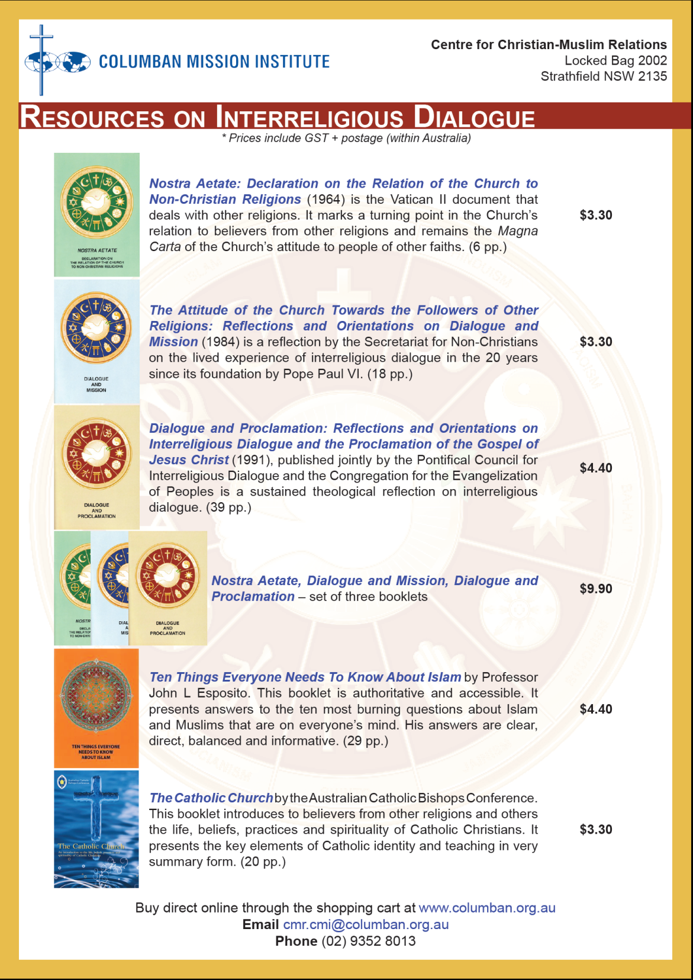
  Resources on Interreligious Dialogue
  www.columban.org.au

Slide 17
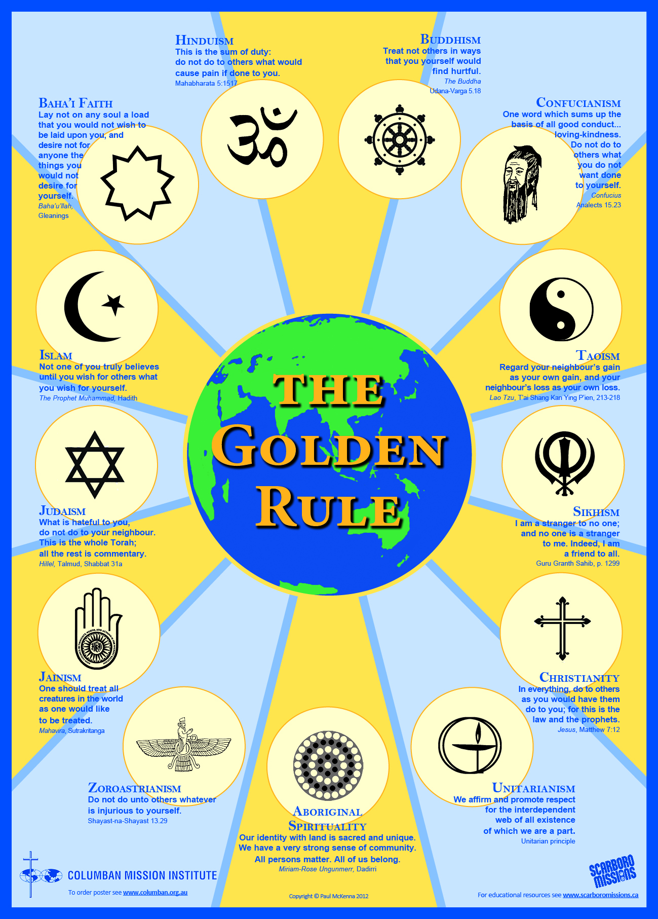
    The
    Golden
    Rule
    www.columban.org.au/thegoldenrule

