Slide 1
Living and Leading Mission in the Spirit of Mary MacKillop

Slide 2
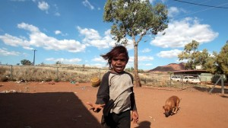

Slide 3
“What are you going to do
about the children?”

Slide 4
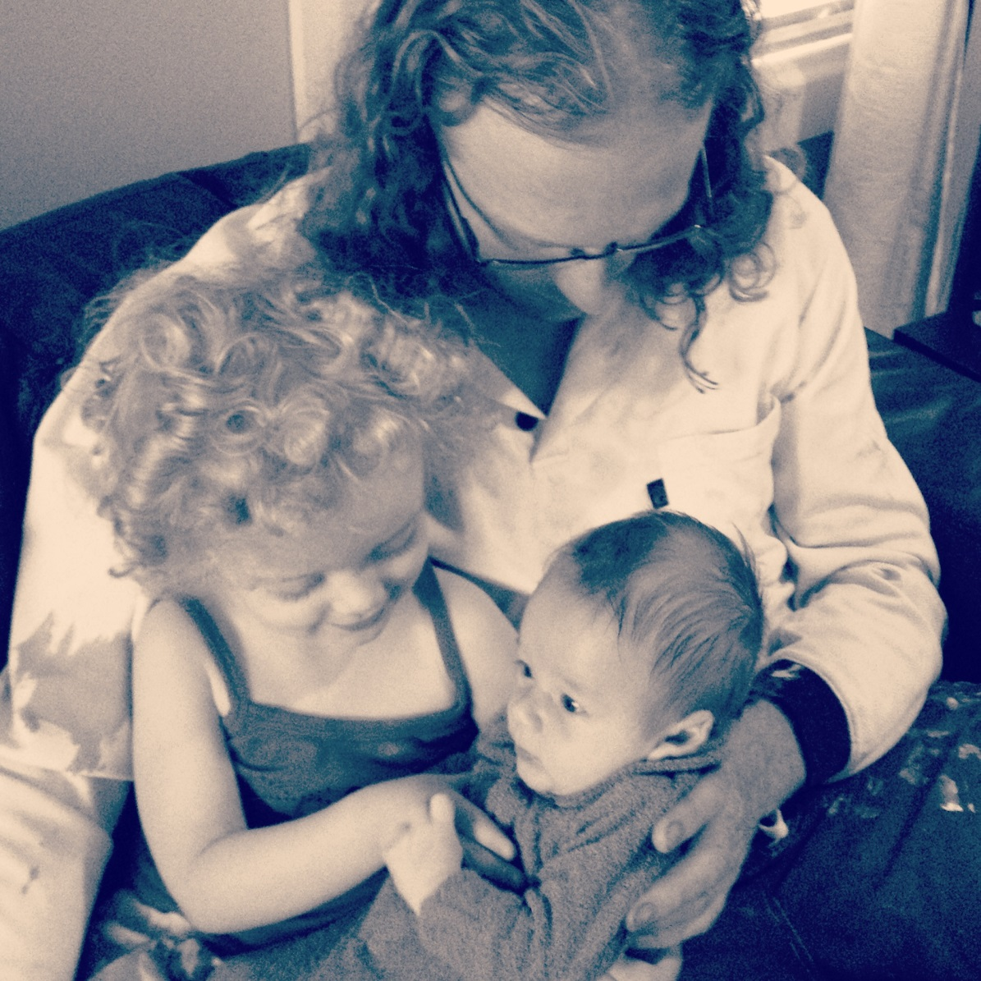

Slide 5
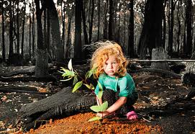
The Nature of Mission
I have come that you may
have life and have it to the full.
Jn 10:10

Slide 6
The Spirit of God is upon me,
Because God has anointed me
To preach good news to the poor.
God has sent me to proclaim release to the captives
And recovering of sight to the blind,
To set at liberty those who are oppressed,
To proclaim the acceptable year of God.
Lk 4: 18-19

Slide 7
The kingdom aims at transforming human relationships; it grows gradually as people slowly learn to love, forgive and serve one another.
…. the kingdom of God is the manifestation and realisation of God’s plan of salvation in all its fullness.
(RM 15)

Slide 8
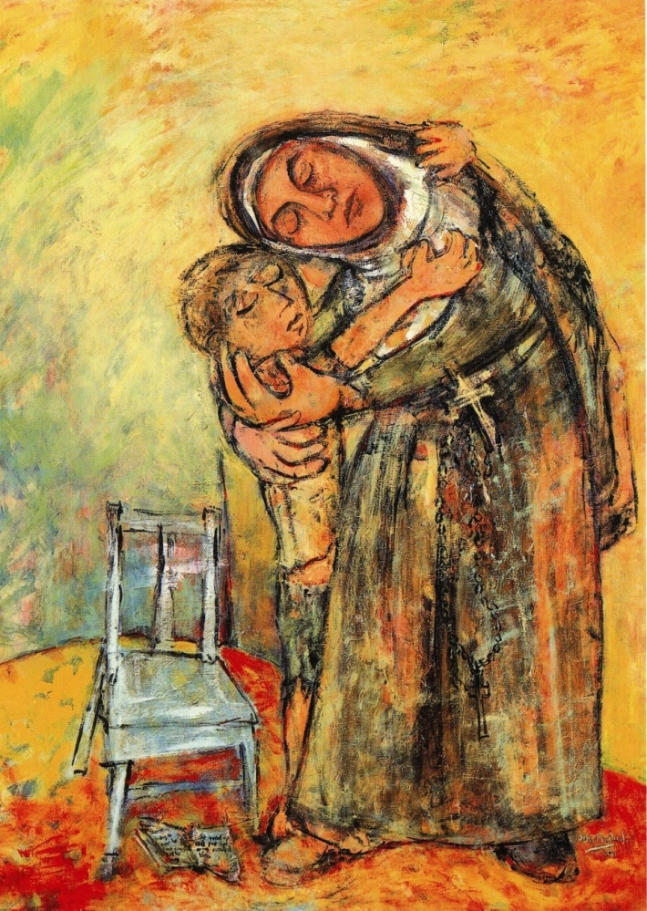
God wants us
by every means
in our power
to lead others to life.
MM 1899

Slide 9
Held in God’s hospitable heart
we draw strength to respond
to places of violence, fear and insecurity in our world,
the places of incompleteness and limitation in ourselves.
Called to deep respect and reverence for difference
we enter uncharted territory with trust.

Slide 10
With courageous generosity
we listen again for the cry of the poor.
Enlivened by the Cross we can embrace difference
we reignite our passion for mission
and we walk as one
revealing the hospitable heart of God.
25th General Chapter 2007

Slide 11
Leadership for Mission
Articulating God’s mission at the heart of this ministry with authenticity and integrity
Promoting respectful personal and professional engagement among all engaged in the ministry
Transformational ministry to make God’s mission accessible, contemporary and effective.

Slide 12
Articulating the Mission
Never see a need
without trying to do
something about it.
MM1871

Slide 13
Respectful Engagement
A Companion is someone who listens to our story and shares our journey
We respond to the other with respect and reverence

Slide 14
Transformational Ministry
Who are the marginalised?
Who are the isolated?
Who is confronted by suffering?
Who needs to experience the compassionate love of God?

Slide 15
Responding to Need
“What are you going to do
about the children?”

Slide 16
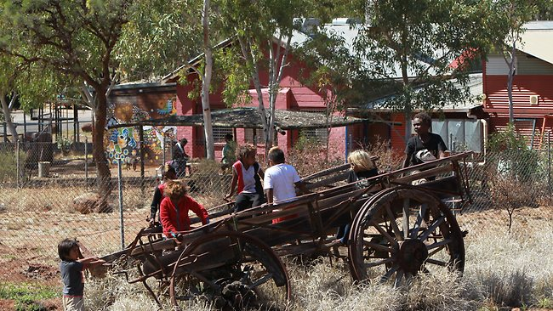
What has happened in this place to cause such a disconnection from self, family and the wider community?

Slide 17
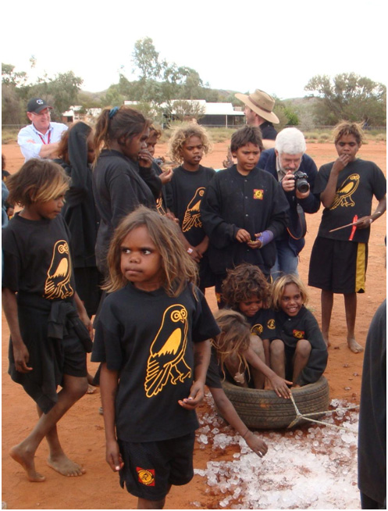
What does the
reign of God
mean, call for
or demand in
this situation?

Slide 18
This good news is not "pie in the sky bye and bye," consolation after death for those who patiently bear irremediable misery in this life. It is "release to captives," "freedom to the oppressed," a new state of affairs, here and now, in which domination, exclusion, stigma, discrimination, oppression of all kinds by state and Church is overcome.
Schneiders S., Tasks of those who choose the prophetic life style, 2010

Slide 19
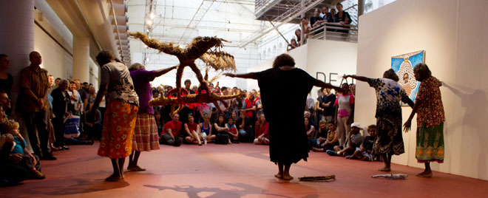

Slide 20
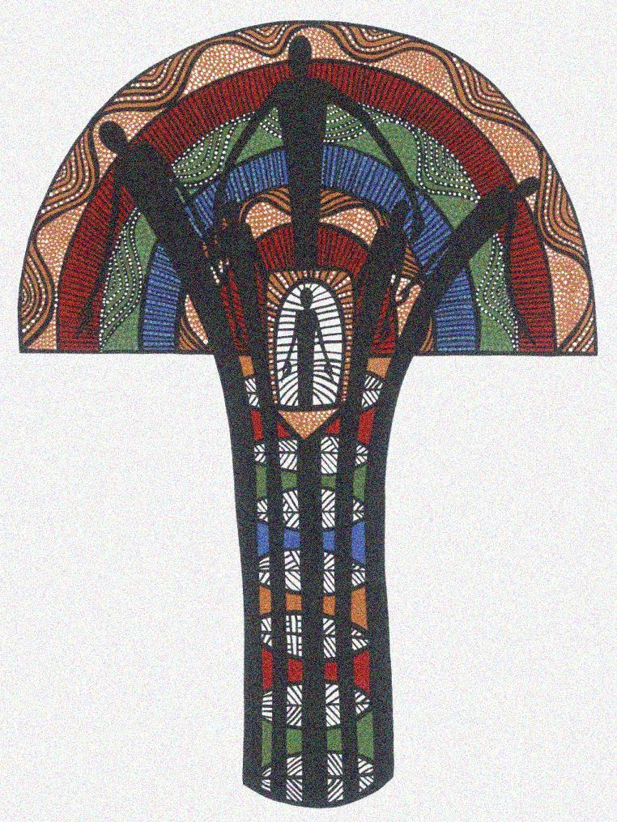
Seasons for Healing
Strong spirit
Strong culture
Strong people
Aboriginal and Torres Strait Islander
Healing Foundation
Notes:
The new tree symbol has been seen a couple of times already today but we would like to take the opportunity to explain the symbolism to you:
Tree Diagram: the Tree of Lives
The tree’s trunk is coloured to represent Aboriginal individuals/family members and community members grounded in the strength and beauty of their traditional ways.
The ring bands in the trunk are growth markers showing how belief in culture strengthens the people to grow towards self-determination.
The trees leaves are coloured to represent the cycles of the earth, to give a sense of wholeness to our life story.
This tree affirms and supports the Healing Foundation logo: Strong Spirit Strong Culture Strong People

Slide 21
We all exist solely for this –
to be the human place God has chosen for his presence, his manifestation, his epiphany.
Thomas Merton, The Living Bread, 147

Slide 22
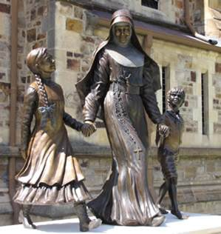
Do what you can
with the means
at your disposal
and leave
all the rest
calmly to God.
Mary MacKillop 1888

