Slide 1


Catholic Social Teaching and the
Social Determinants of Health

Slide 2

A presentation in 3 parts
1 - The Problem
Social factors – the social determinants of health - influence a person’s chronic illness and premature death risks
Those in the lowest socioeconomic groupings have more avoidable chronic illness and die earlier than those in higher groups
2 - The international solution
The World Health Organisation Commission on Social Determinants in 2008 outlined a global action plan for all member nations
3 - The Church’s mission as part of the international solution
CHA’s is working to a strategy to have the WHO action plan adopted in Australia
The Church’s mission has been involved in social determinants for centuries; the principles of Catholic social teaching find contemporary expression in the social determinants of health

Slide 3
The problem

Slide 4
What are social determinants?
Social determinants are factors in society or in our living conditions that contribute to good or bad health
  Agren, G (2003), Sweden’s new public health policy: National public health objectives for Sweden, National Institute of Public Health, Stockholm, Sweden.
Determinants described as causal pathways or chains that affect health
  Australia Institute of Health and Welfare, (2008) Australia’s Health, Edition No 11, The Australian Government, Canberra.
Ten key social determinants of health: the social gradient, stress, early life, social exclusion, work, unemployment, social support, addiction, food, and transport
  Marmot, M, & Wilkinson, R (2003), Social Determinants of Health: The Solid Facts, World Health Organisation, Denmark, Holland.

Slide 5
The social gradient
Social gradient recognises that people “further down the social ladder run at least twice the risk of serious illness and premature death as those near the top.”
  Marmot, M, & Wilkinson, R (2003), Social Determinants of Health: The Solid Facts, World Health Organisation, Denmark, Holland.
“The poor health of the poor, the social gradient in health within countries, and the marked health inequities between countries are caused by the unequal distribution of power, income, goods, and services.”
  Commission on Social Determinants of Health (2008), Closing the gap in a generation, World Health Organisation, Geneva, Switzerland.

Slide 6
Illustration determinant: birth weight
In developed countries, the most important factor in determining birth weight was cigarette smoking, followed by nutrition and pre-pregnancy weight. In developing countries the major determinants were nutrition, low pre-pregnancy weight, and malaria.
  Kramer, M., (1987), Determinants of low birth weight: methodological assessment and meta-analysis. Bull World Health Organ. 65(5):663-737.
21 Jan 2012: Northwestern University study of 3,725 same sex twins on the Swedish Twin Registry finds low birth weight is a determinant of autism spectrum disorder.
  Study to be published in the journal Psychological Medicine.
20 Jan 2012: Erasmus Medical Centre in The Netherlands study analysed data on 5,125 children in the Generation R Study finding rapid infant weight gain during the first three months of life is a determinant of the risk of asthma.
  Study to be published in the American Journal of Respiratory and Critical Care Medicine

Slide 7
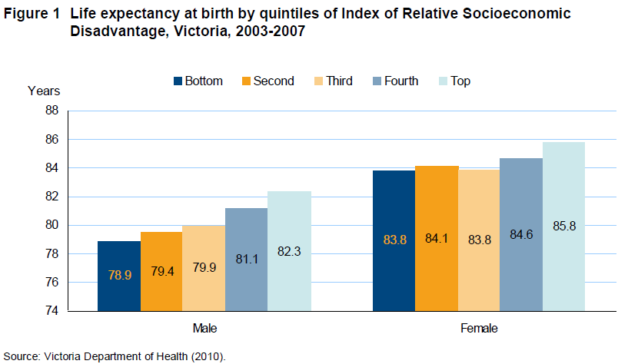
Australia

Slide 8
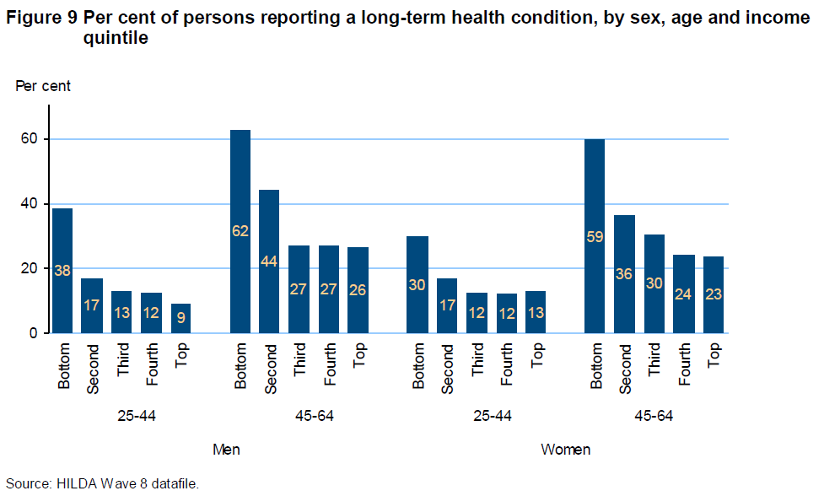

Slide 9
Cost of inaction
The 2012 CHA- NATSEM report found implementing the WHO recommendations could see:
500,000 Australians avoid suffering a chronic illness;
170,000 extra Australians enter the workforce, generating $8 billion in extra earnings;
$4 billion in welfare support payments saved each year;
60,000 fewer people admitted to hospital annually, resulting in savings of $2.3 billion in hospital expenditure;
5.5 million fewer Medicare services utilised each year, resulting in annual savings of $273 million;
5.3 million fewer Pharmaceutical Benefit Scheme scripts being filled each year, resulting in annual savings of $184.5 million.

Slide 10
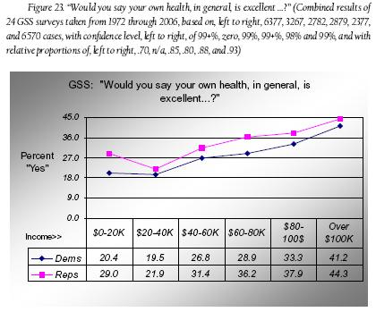
America

Slide 11
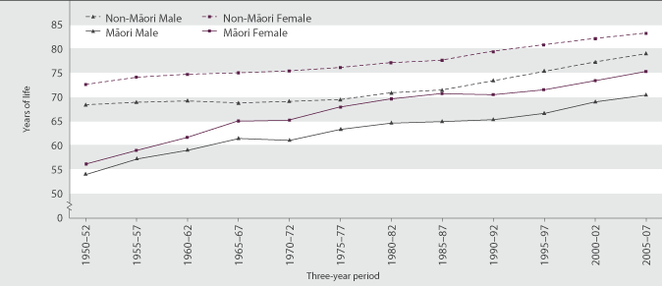
New Zealand
In 2005–2007, males in the least deprived 10th of small areas in New Zealand could expect to live 8.8 years longer than males in the most deprived 10th of small areas (82.1 versus 73.3 years). For females, the difference was smaller, but still substantial, at 5.9 years (84.6 versus 78.7 years).

Slide 12
The international solution

Slide 13
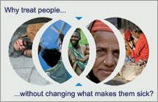
2008 WHO Framework
Improve daily living conditions
Tackle the inequitable distribution of power, money, and resources
Measure and understand the problem and assess the impact of action

Slide 14
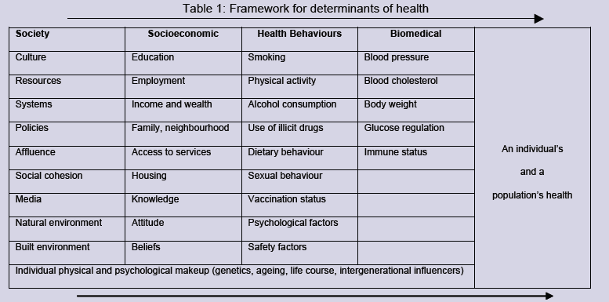
Australian action framework

Slide 15
The Church’s mission as part of the international solution

Slide 16
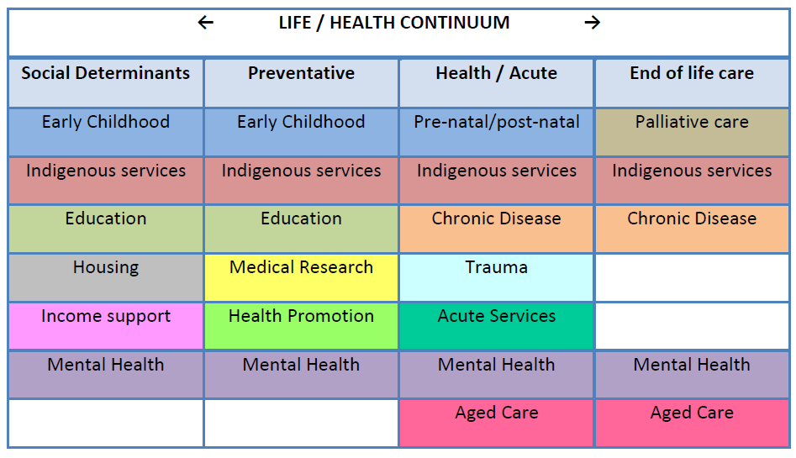
Church’s mission in health

Slide 17
CHA’s social determinants strategy
2008 – WHO global action plan
2009 – CHA strategy paper endorsed
2010 – NATSEM Health lies in wealth
2011 – Determining the Future: Fair go & Health for all
2012 – NATSEM Cost of inaction on SDoH
2013 (Feb) – 58 member SDOHA
2013 (March) – Senate back WHO implementation

Slide 18
What is Catholic Social Teaching?
Australian Catholic Social Justice Council:
Catholic Social Teaching (also known as Catholic Social Doctrine) sums up the teachings of the Church on social justice issues.
It promotes a vision of a just society that is grounded in the Bible and in the wisdom gathered from experience by the Christian community as it has responded to social justice issues through history.
The social teachings are made up of three distinct elements: principles for reflection; criteria for judgment; and guidelines for action. Each has a different level of authority.
Source: Sandie Cornish B.Ec. (Nctle), Lic. Soc. Sci. (PUG), M. Pub. Pol.(UNE) accessed at http://www.socialjustice.catholic.org.au/content/pdf/cst_intro.pdf

Slide 19
Social teaching in practice
“There is a lot of pious nodding towards social justice in some Catholic circles, yet this social teaching is often not well integrated into the lives and thinking of many Catholics.
We do well with practical, hands-on projects, with our health care, welfare work and education especially, but often perform poorly in debate over the larger issues facing society, and in attempts to inculcate a social justice perspective in the public forum.”
Source: Rev Dr Bruce Duncan CSSR, (2011), How to make use of Catholic Social Teaching, Yarra Theological Union.

Slide 20
4 steps to Catholic Social Teaching
Church social teaching emerges as responses to specific social, economic or political developments, and so much depends on one’s interpretation of changing contexts.
Social teaching has a history as a body of thought, particularly as reflected in the papal encyclicals
Social teaching develops not in a consistent flow, but in fits and starts, with moves forward and sometimes reverses.
Encyclicals presuppose lively debate and social activism among Catholic and other concerned people: in other words, the groundwork must first be done by lay people themselves, working to improve human wellbeing, and taking an active role in shaping public policy and opinion. This work of social transformation is primarily the vocation of lay people with all the expertise they can bring to these tasks. In this they generally act independently of the Church and on their own initiative.
Source: Rev Dr Bruce Duncan CSSR, (2011), How to make use of Catholic Social Teaching, Yarra Theological Union.

Slide 21
Caritas in veritate
Encyclical letter of Benedict XVI (June 2009) saw the Pope focus attention on global issues today; hunger, poverty and development, and environmental sustainability (which are each social determinants of health).
Benedict strongly reaffirmed the Church’s duty to engage in social advocacy and promote social justice.
Irish Catholic Bishops Conference response to Caritas in veritate involved the issue of Caring for Health Ireland:
“The reduction of social inequalities in health should be a core target of health policy and should be seen as an important component of the reduction of social inequalities more generally.”

Slide 22
Pontifical Council for Health
President of the Pontifical Council for Health Care, Archbishop Zygmunt Zimowski, said in his address to the World Health Organisation's 64th World Health Assembly (2011):
“The importance of education, housing, and healthy living in addressing the social determinants of health is urgent within our times. It is the work of the Church, and the call of the Gospel ,and it is also the work of this World Health Organisation.”

Slide 23


Principle of Catholic Social Teaching | Social Determinant of Health Objective | What more can Church in Australia contribute?
Dignity of the Human Person
The Common Good
Preferential Option for the Poor
Rights and Duties
Participation
Economic Justice
Solidarity
Stewardship
Promotion of Peace
Subsidiarity

Slide 24
Coming soon
Catholic Social Teaching and Social Determinants of Health
Due for release in August 2013

Slide 25
Martin Laverty
Catholic Health Australia
martinl@cha.org.au
+61 2 6203 2777
www.cha.org.au

